Slide 1
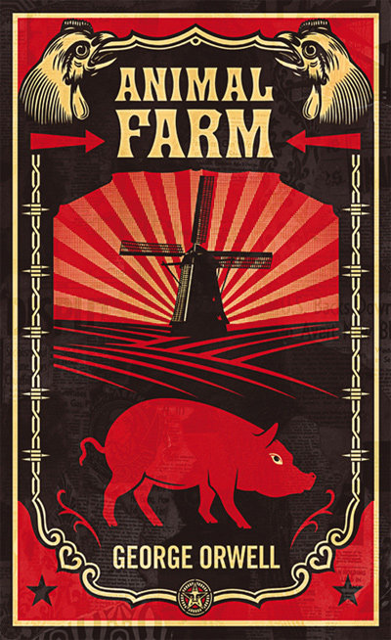
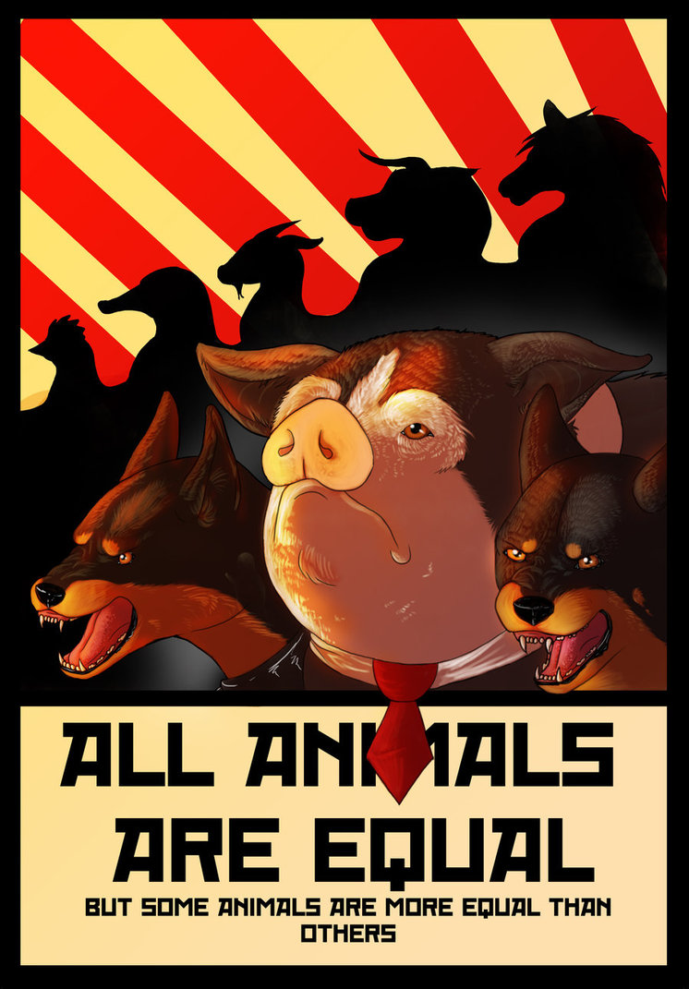

Slide 2
What is an allegory?
A story, poem, or picture that can be interpreted to reveal a hidden meaning, typically a moral or political one.
Some fictional characters and events may correspond exactly with things that happened in real life.

Slide 3
Animal Farm
Animal Farm is an allegorical book.
It was written by George Orwell and first published in England in 1945.
The book reflects the events leading up to the Russian Revolution of 1917 and then on into the Stalinist era of the Soviet Union.
Certain animals are based on Communist Party leaders: the pigs Napoleon and Snowball are figurations of Joseph Stalin and Leon Trotsky.
It is a satirical critic of Joseph Stalin, the Soviet Union, and Communism.
Orwell believed the Soviet Union had become a brutal dictatorship, built upon a cult of personality, and enforced by a reign of terror.
Orwell stated he wanted his book to “to fuse political purpose and artistic purpose into one whole.”

Slide 4
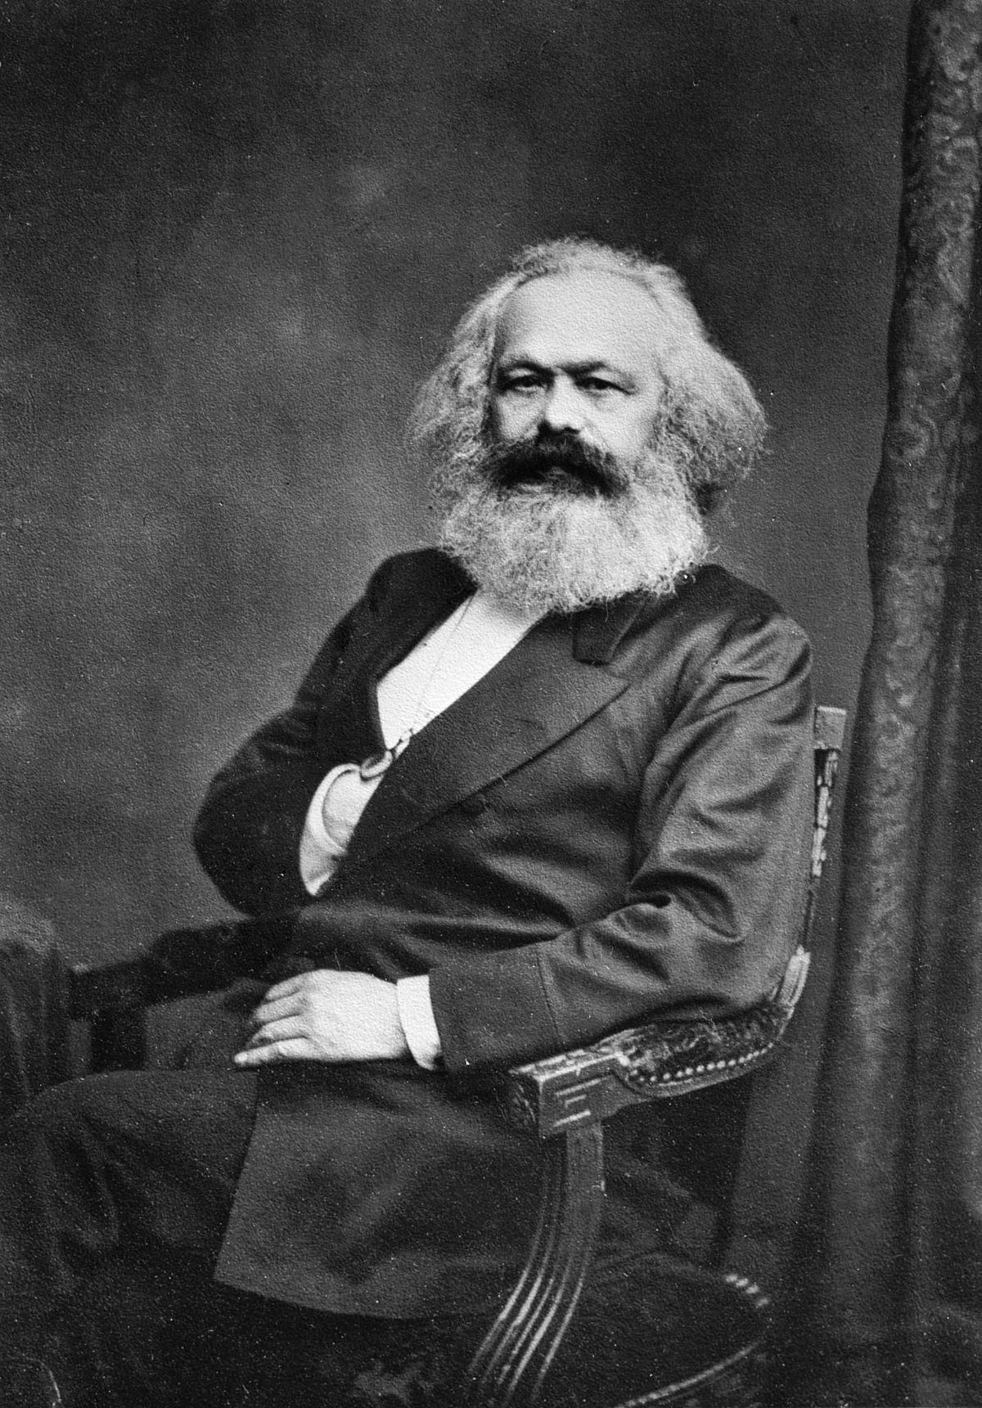
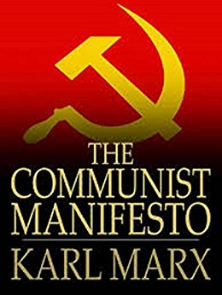
Karl Marx
The Communist Manifesto (1848)

Slide 5
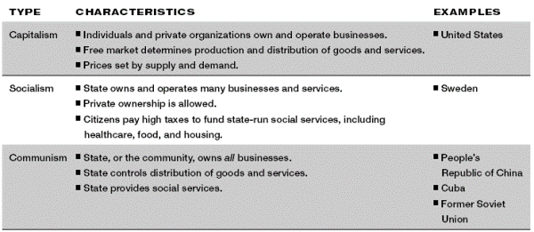

Slide 6
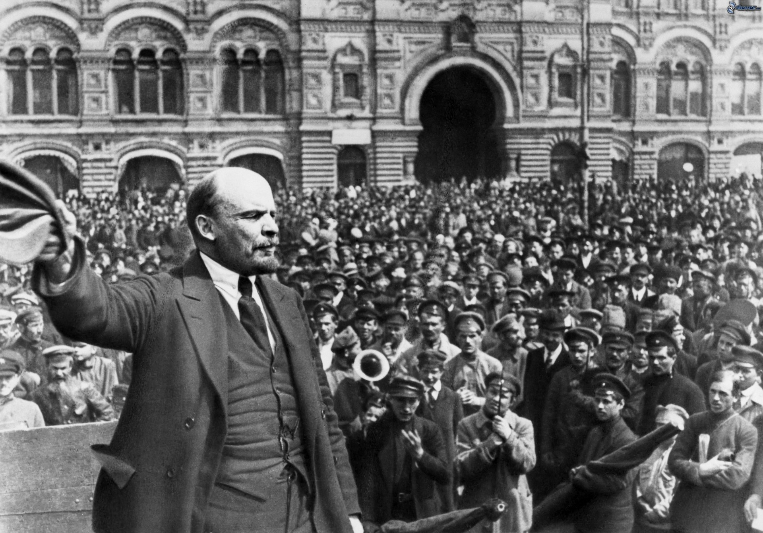
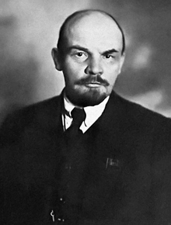
Vladimir Lenin
Bolshevik Party Leader
Dies in 1924

Slide 7
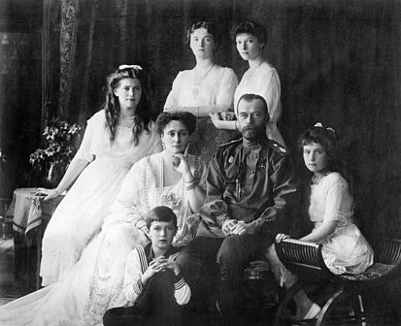

Slide 8
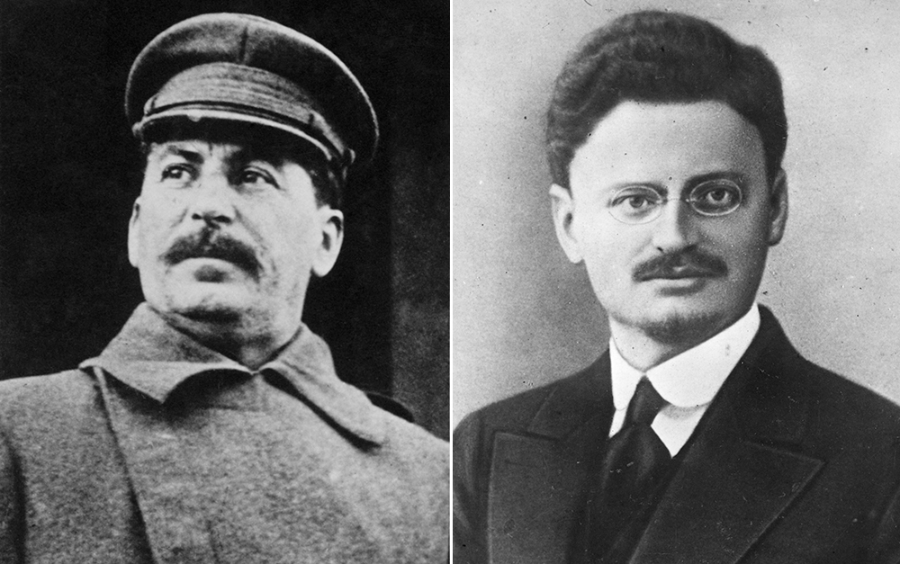

Slide 9
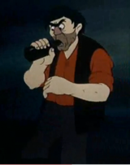
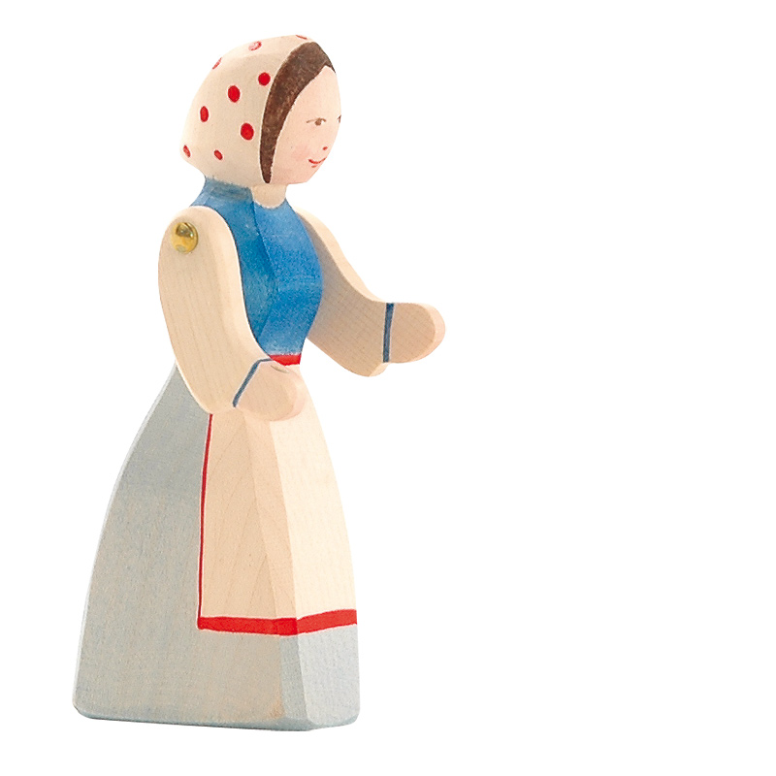

Slide 10
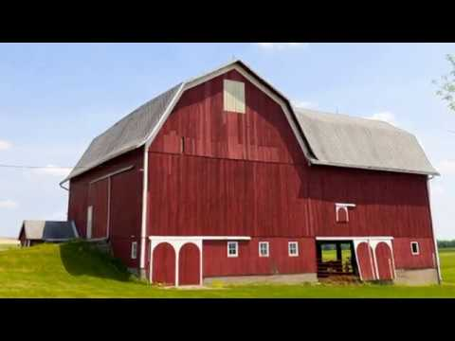

Slide 11
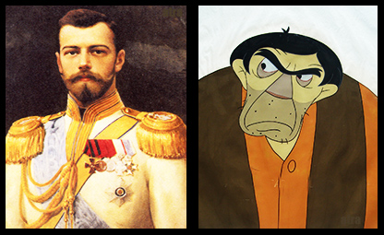
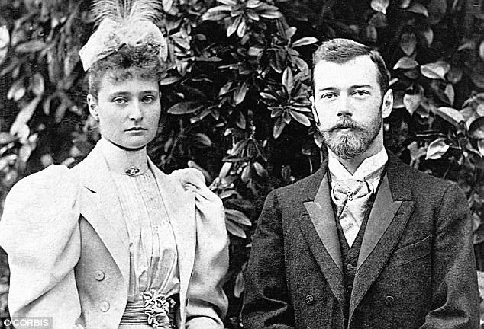

Slide 12
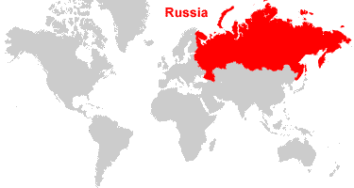

Slide 13
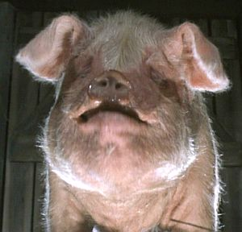
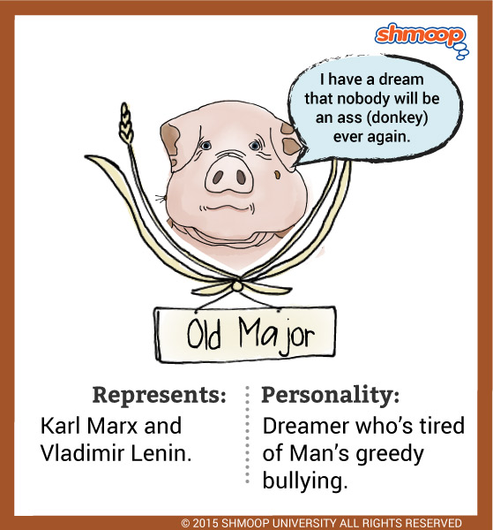

Slide 14
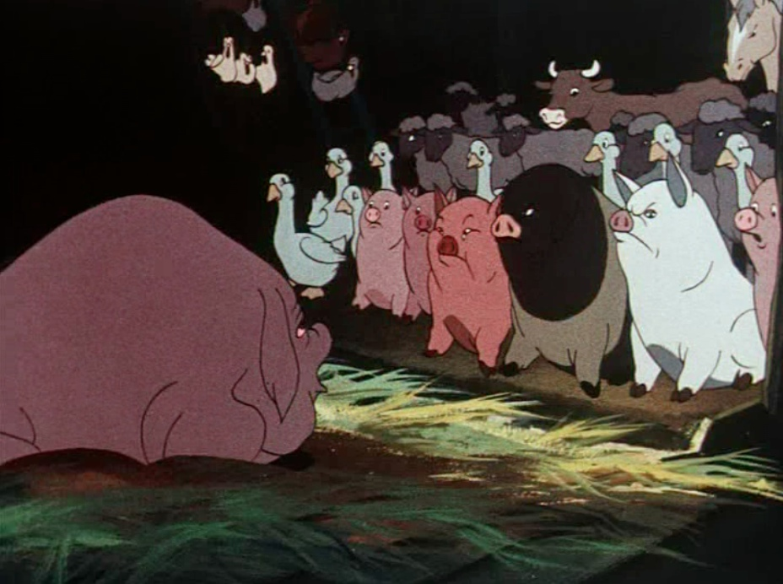

Slide 16
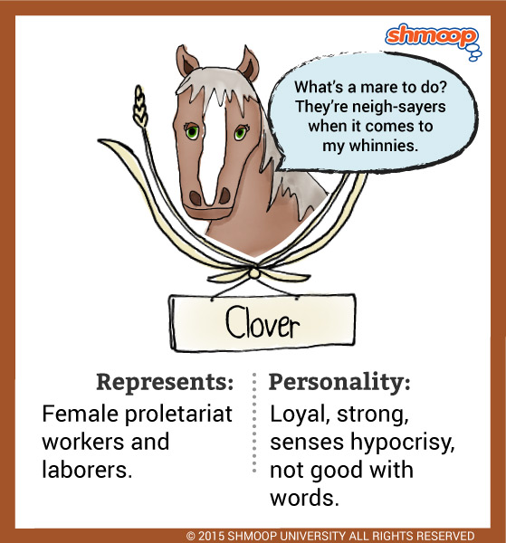

Slide 17
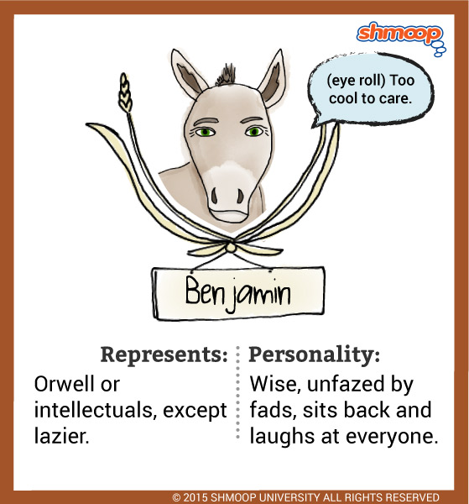
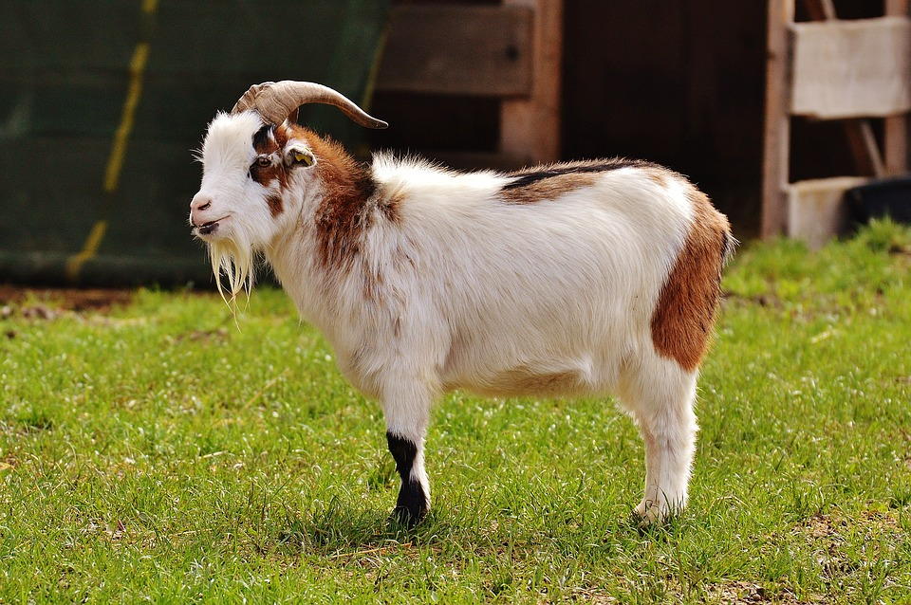

Slide 18
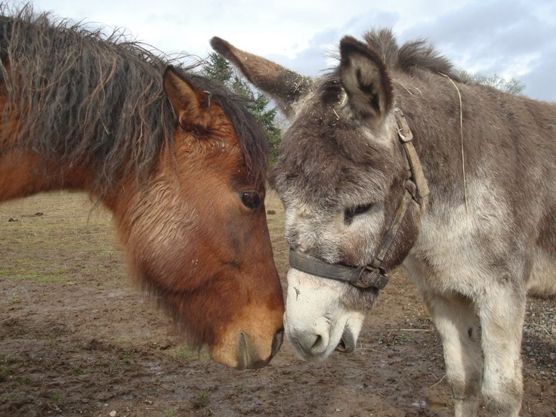

Slide 21
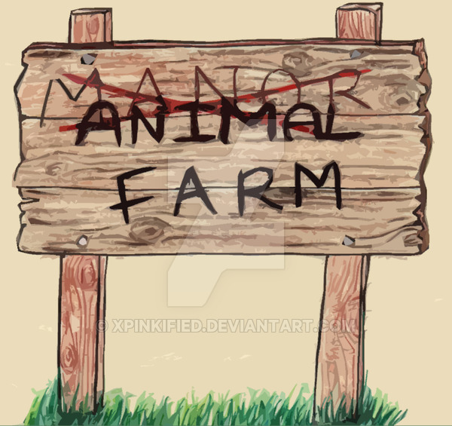

Slide 22
