Slide 1
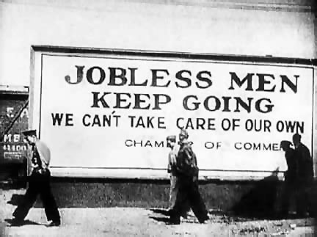
The Great Depression
1930’s

Slide 2
Objects:
People:
Time/Title:
Inferences: Because I see ___________________, I can infer…
Conclusion: The most important thing in this cartoon is _________________ because it sends the message that…

Slide 3
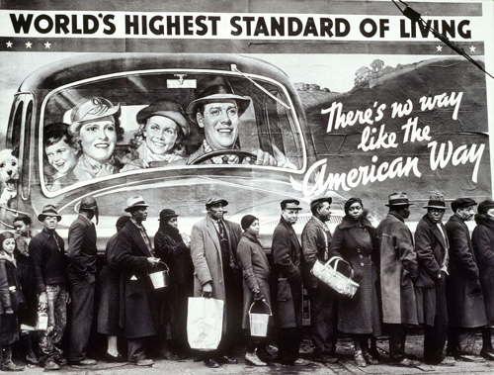
Objects:
People:
Time/Title:
Inferences: Because I see ___________________, I can infer…
Conclusion: The most important thing in this cartoon is _________________ because it sends the message that…

Slide 4
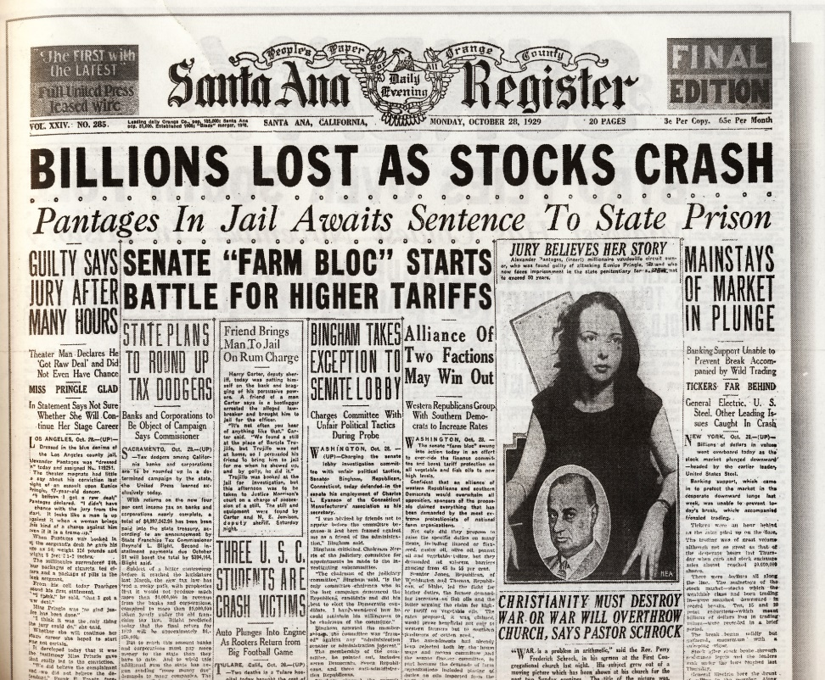
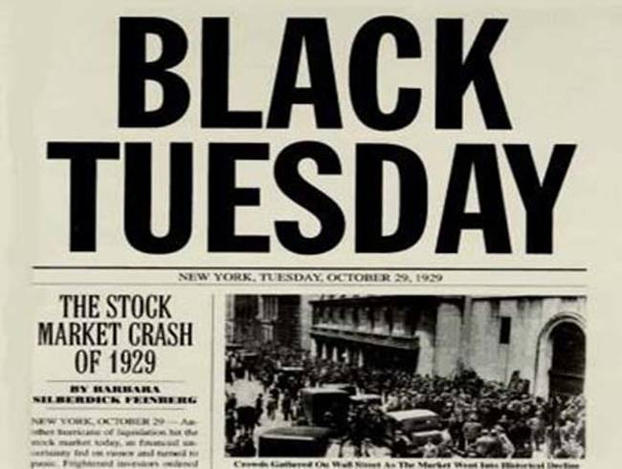
The Great Depression
*Widespread unemployment and poverty in the 1930’s

Slide 5
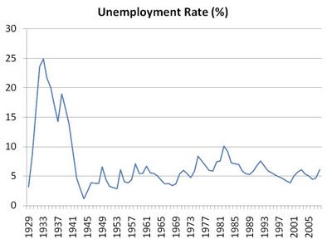

Slide 6
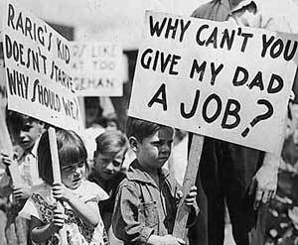

Slide 7
CAUSES

Slide 8
Laissez-Faire Attitudes
*Gov. went back to “hands off” business after WWI

Slide 9
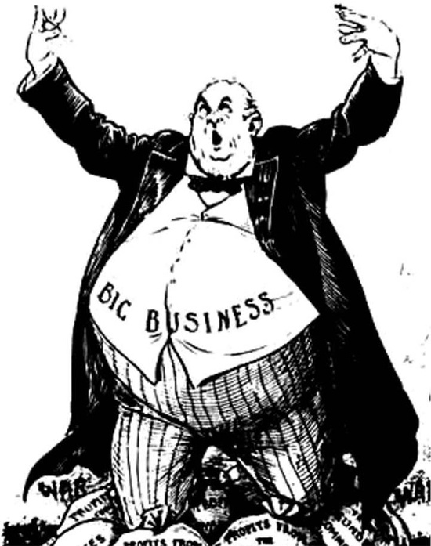

Slide 10
Overproduction
*Overproduction= underconsumption (too many goods, not enough buyers)
*U.S. businesses earned record profits during 1920s and reinvested much of these funds into making more and more goods.
*By 1929 companies had created a bubble. Workers could no longer continue to fuel this expansion in supply.

Slide 12
Stock Market Overspeculation
*People buying stocks with the assumption that they can always be sold at a profit.

Slide 14
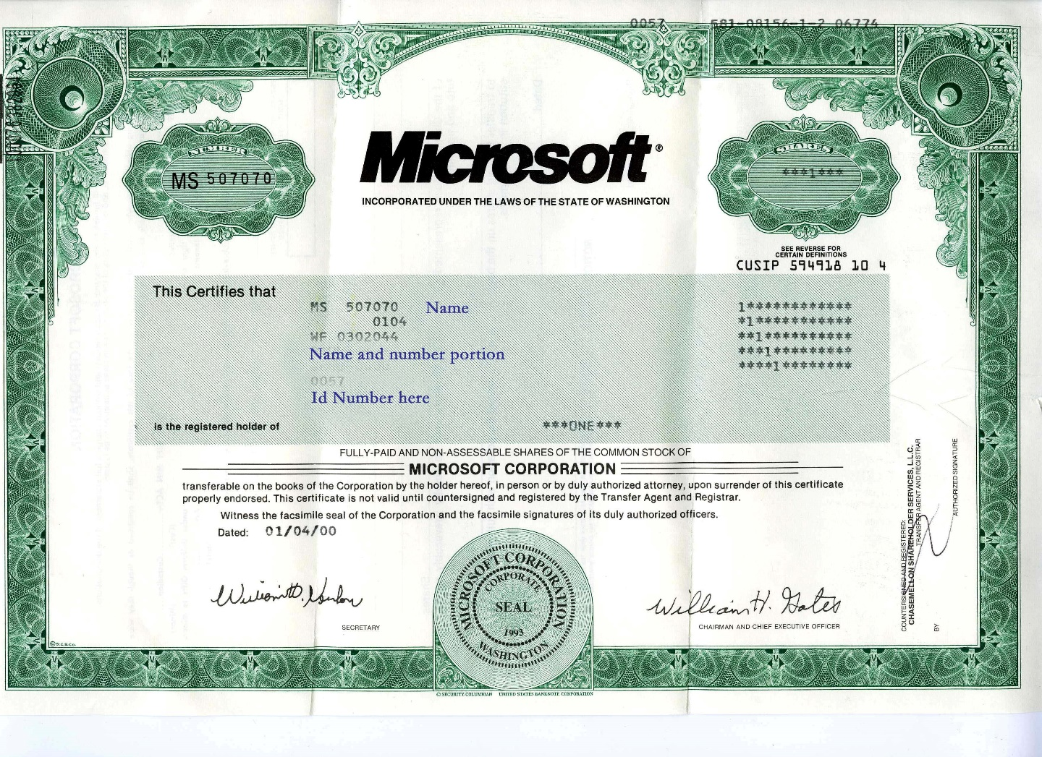
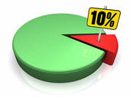
A stock represents partial ownership of a company (shares)

Slide 16
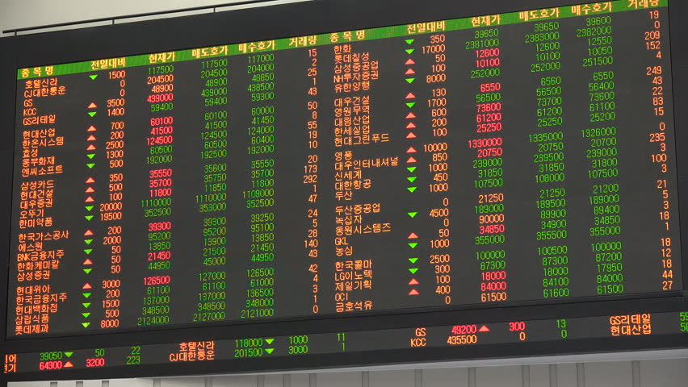

Slide 17
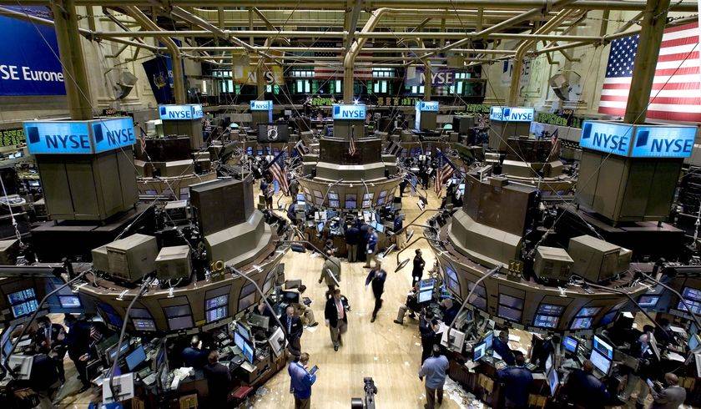

Slide 18
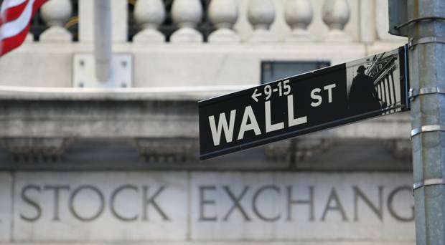

Slide 19
Credit
*Many people buying things on margin= already in debt
*Middle class Americans had already stretched their debt capacities by purchasing automobiles and household appliances on installment plans (buying on margin)

Slide 20
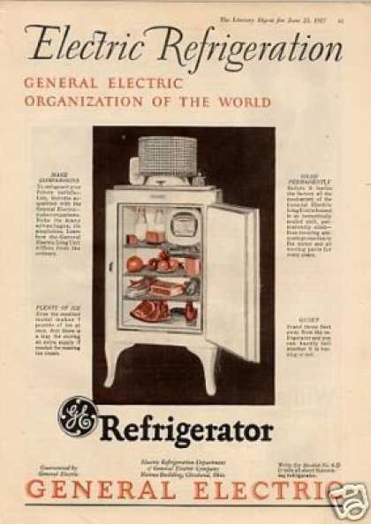

Slide 21
Stock Market Crash (1929)
*Black Tuesday/Wall-Street Crash
*4 day collapse of stock prices
*Panic sell-off assets
*Newspapers fanned the panic with articles about margin sellers, short-selling, and the exit of foreign investors.

Slide 22
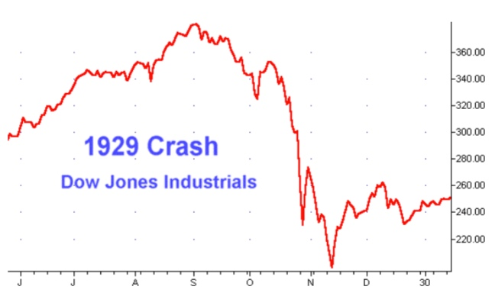

Slide 23
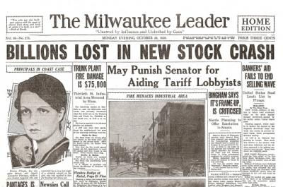

Slide 24
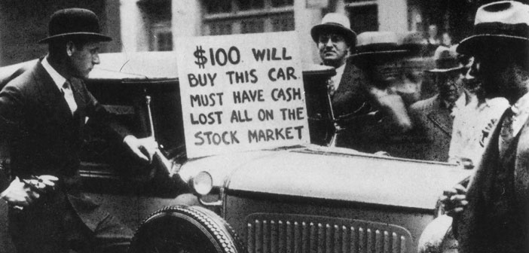

Slide 25
Bank Runs = Bank Failures
*People panic, run to withdraw savings, but banks don’t have all $$$
*Banks began to fail as debtors defaulted on debt

Slide 26
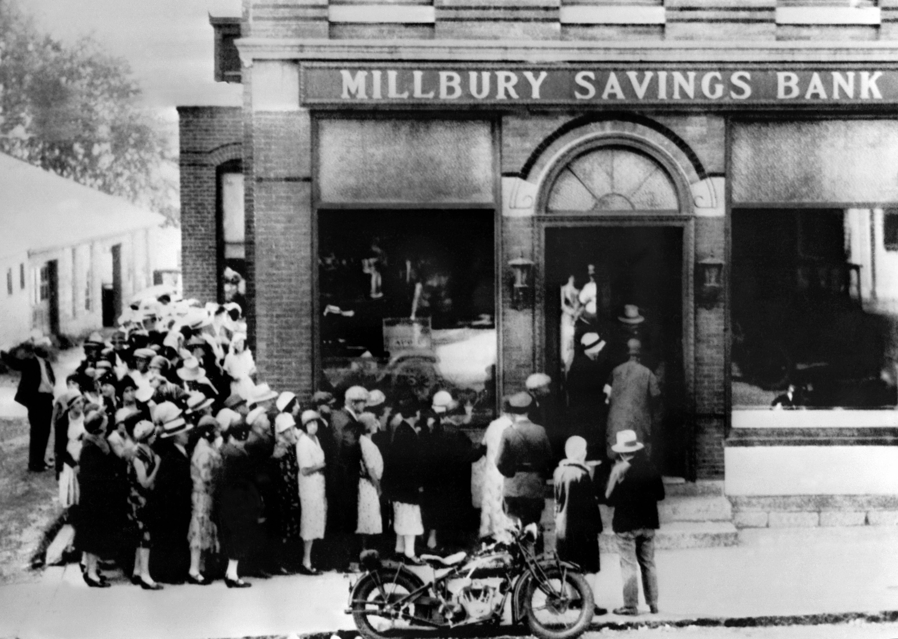

Slide 27
Banks need loan $$$ repaid
People can’t repay loans because they have no $$$
Banks don’t have their $$$ (used for loans)
People want their $$$

Slide 28
Smoot-Hawley Tariff
*Very high tariffs (taxes on imports) *Buy only from US!= ☹ International trade declined
*Legislation passed in 1930 under President Hoover that established very high tariffs (taxes on imports). Its objective was to reduce foreign imports and stimulate the domestic economy, but it only angered other countries and drastically weakened international trade.

Slide 29
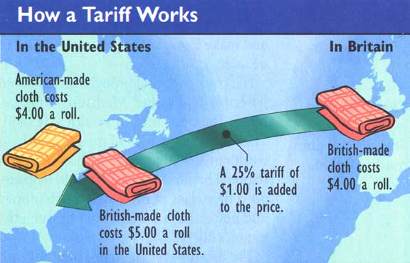

Slide 30
Federal Reserve
*Central bank of the U.S. was unorganized and lacked tools to help banks
*Raised interest rates too late
*Deflation- Federal Reserve did not want to print more money even though people were hiding cash (money in circulation shrunk my 1/3rd)

Slide 31
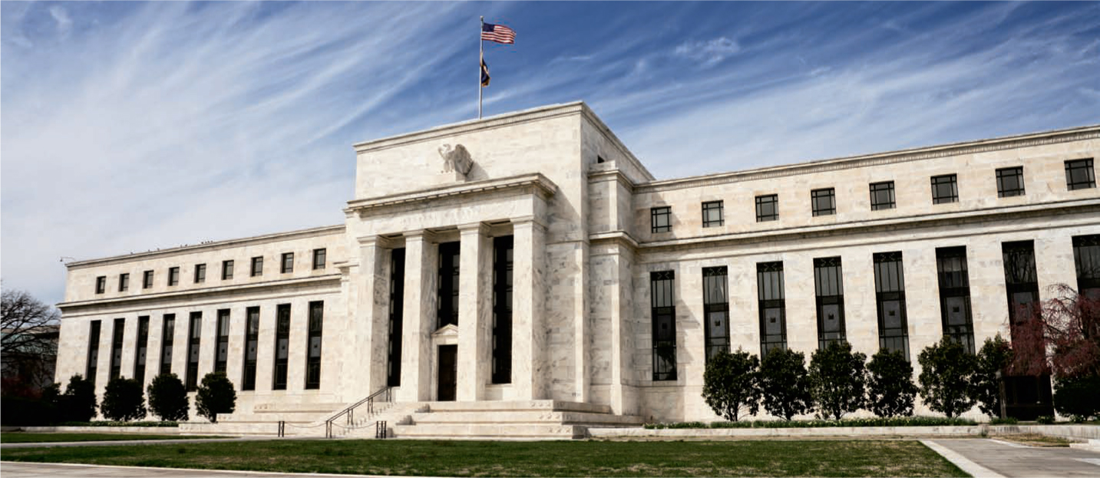

Slide 32
EFFECTS

Slide 33
Unemployment
*Unemployment rate rose above 25%
*Workers were laid off en masse. As people lost their jobs, they were unable to keep up with paying for items they had bought through installment plans; repossessions and evictions were commonplace

Slide 34
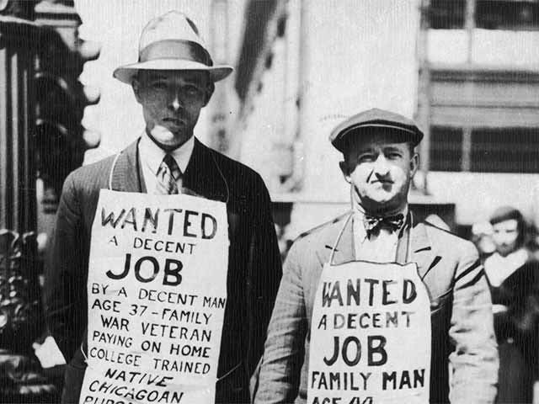

Slide 35
Breadlines
*A line of people waiting to receive free food from gov.
*POVERTY

Slide 36
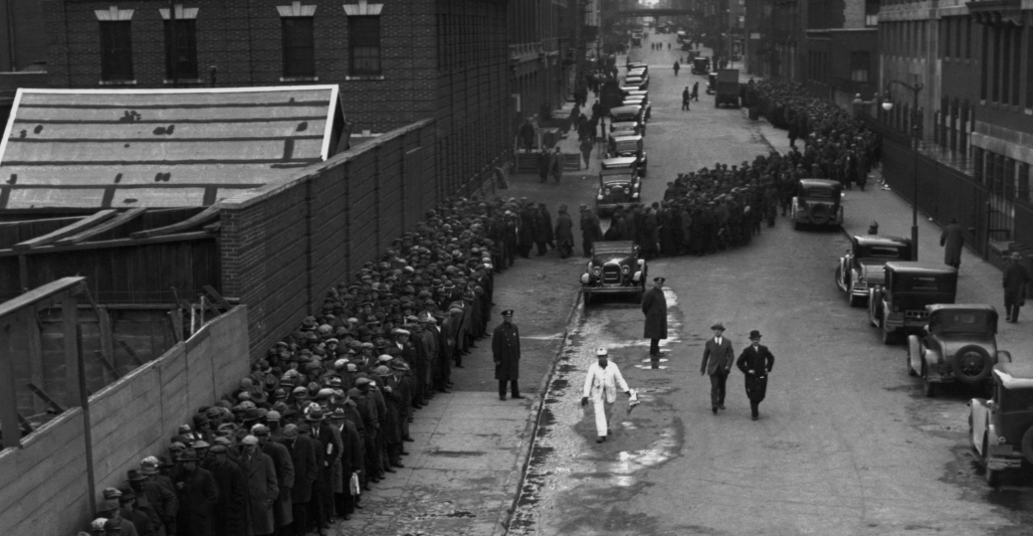

Slide 37
Hooverville (Shanty Town)
*Slum shelters form outside of cities
*Unplanned slum development on the outskirts of cities, dominated by crude dwellings and shelters made mostly of scrap wood, iron, and even pieces of cardboard.

Slide 38
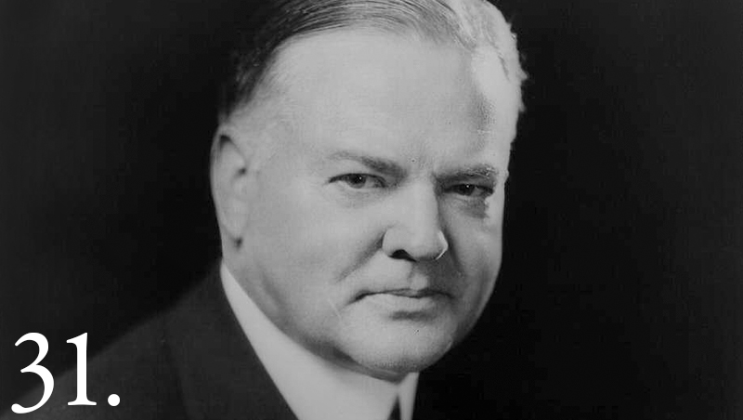

Slide 39
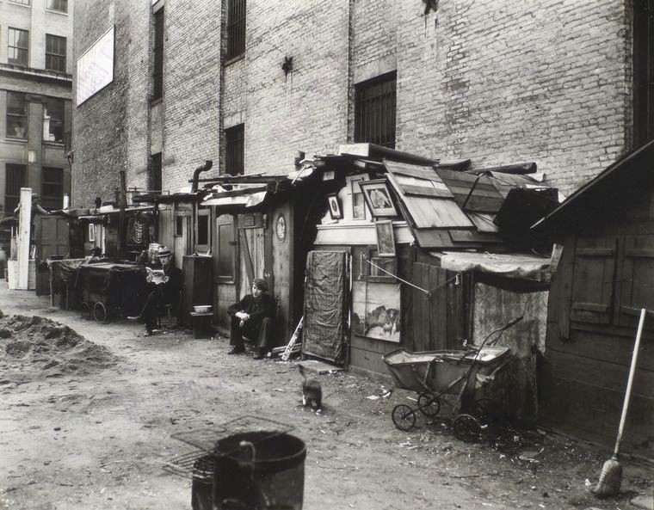

Slide 40
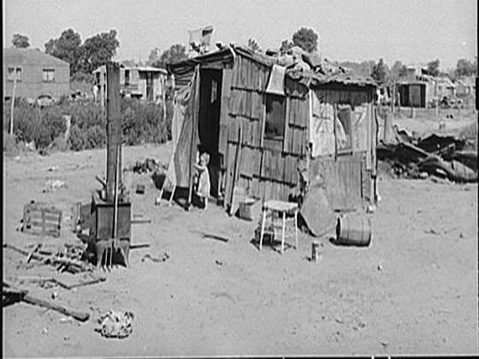

Slide 41
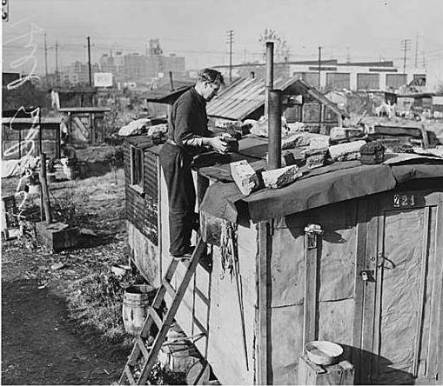

Slide 42
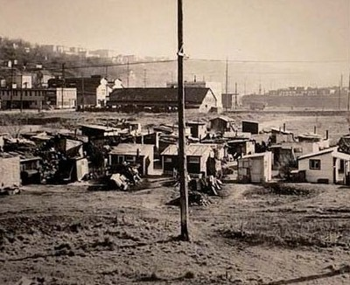

Slide 43
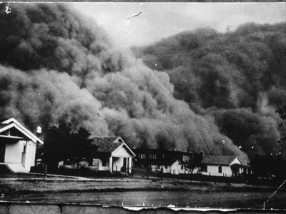
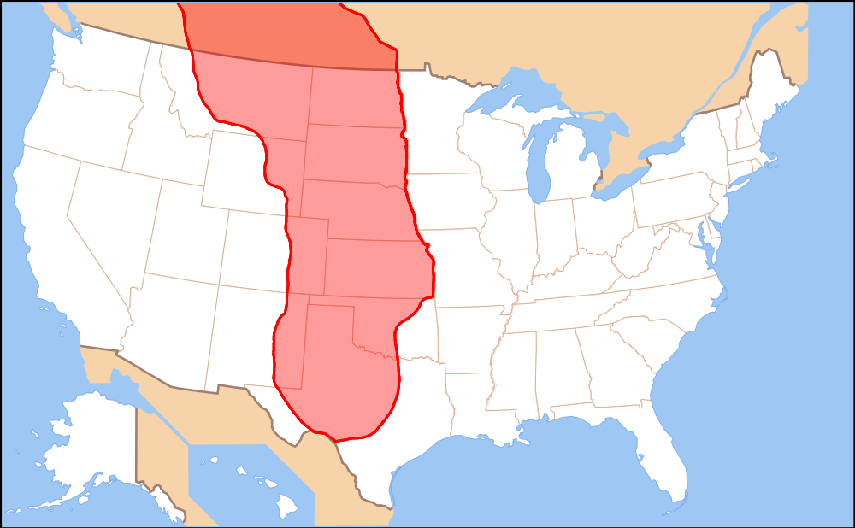
The Dust Bowl
*Poor farming techniques + drought= farmers suffer in Great Plains

Slide 44
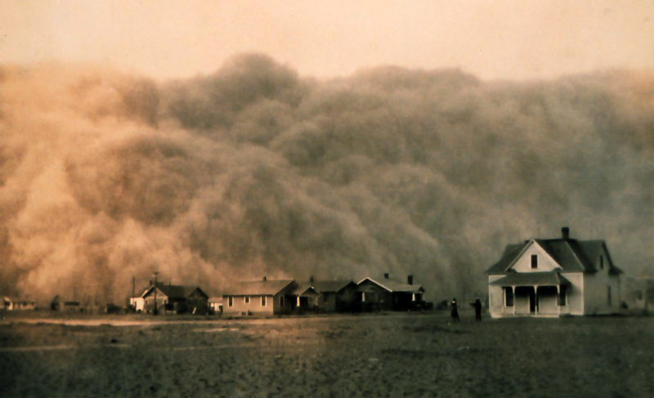

Slide 45
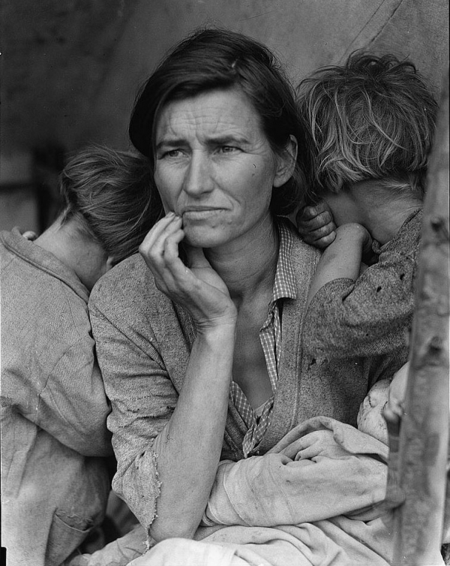

Slide 46
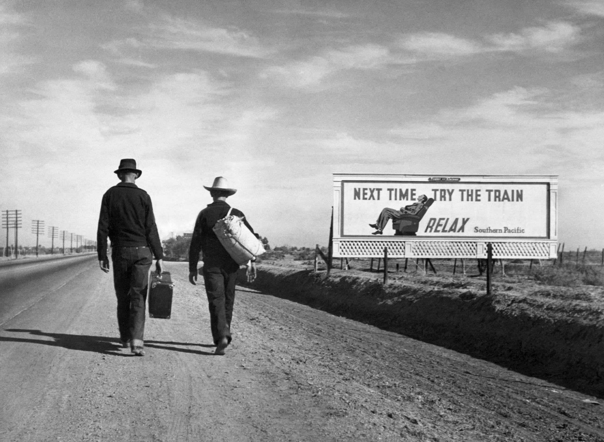

Slide 47
Franklin D. Roosevelt (FDR)
*Elected President in 1933
*New Deal programs created to save U.S. economy
*3 R’s (Relief, Recovery, Reform)

Slide 48
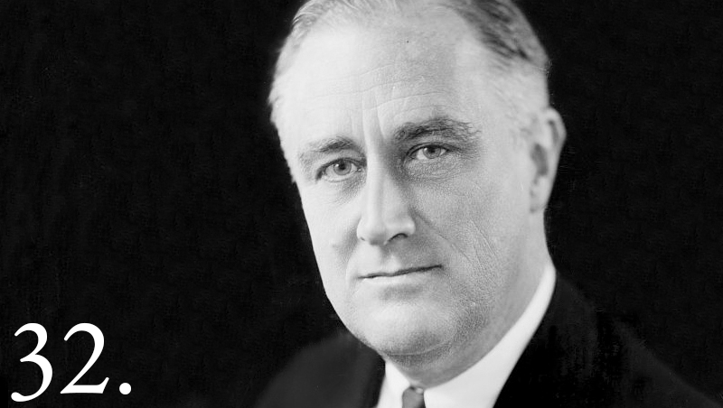

Slide 49
