Slide 1
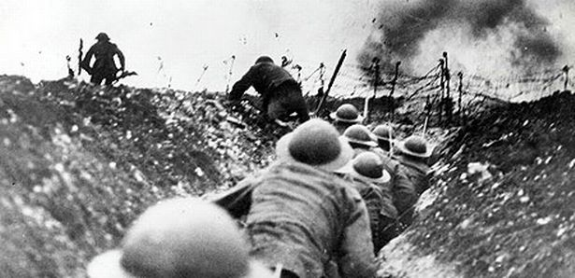
World War I
Effects

Slide 2
Objects:
People:
Time/Title:
Inferences: Because I see ___________________, I can infer…
Conclusion: The most important thing in this cartoon is _________________ because it sends the message that…

Slide 3
Russian Revolution (1917)
*Uprising that destroyed the Tsarist (Czar) autocracy and led to the rise of communism and the Soviet Union in Russia

Slide 4
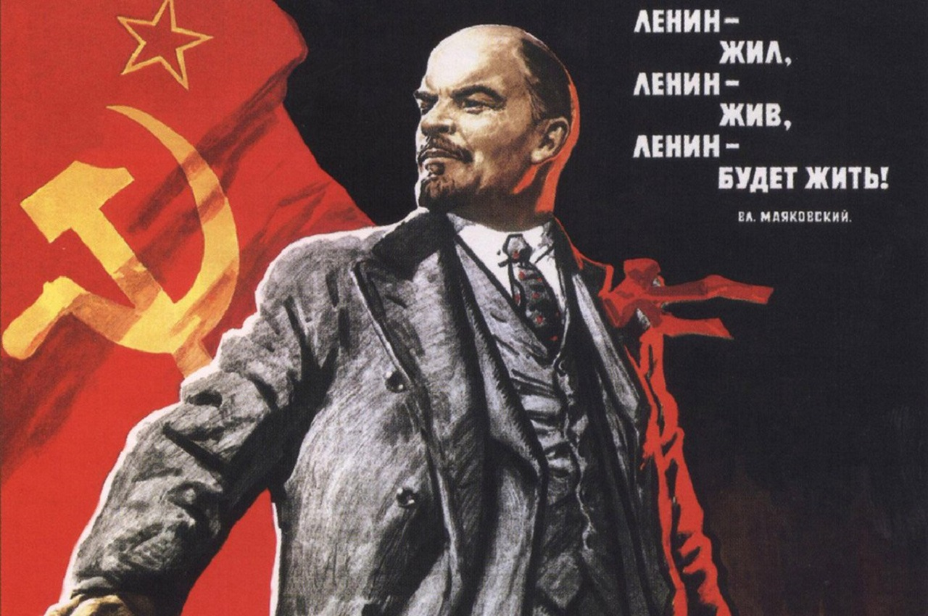

Slide 6
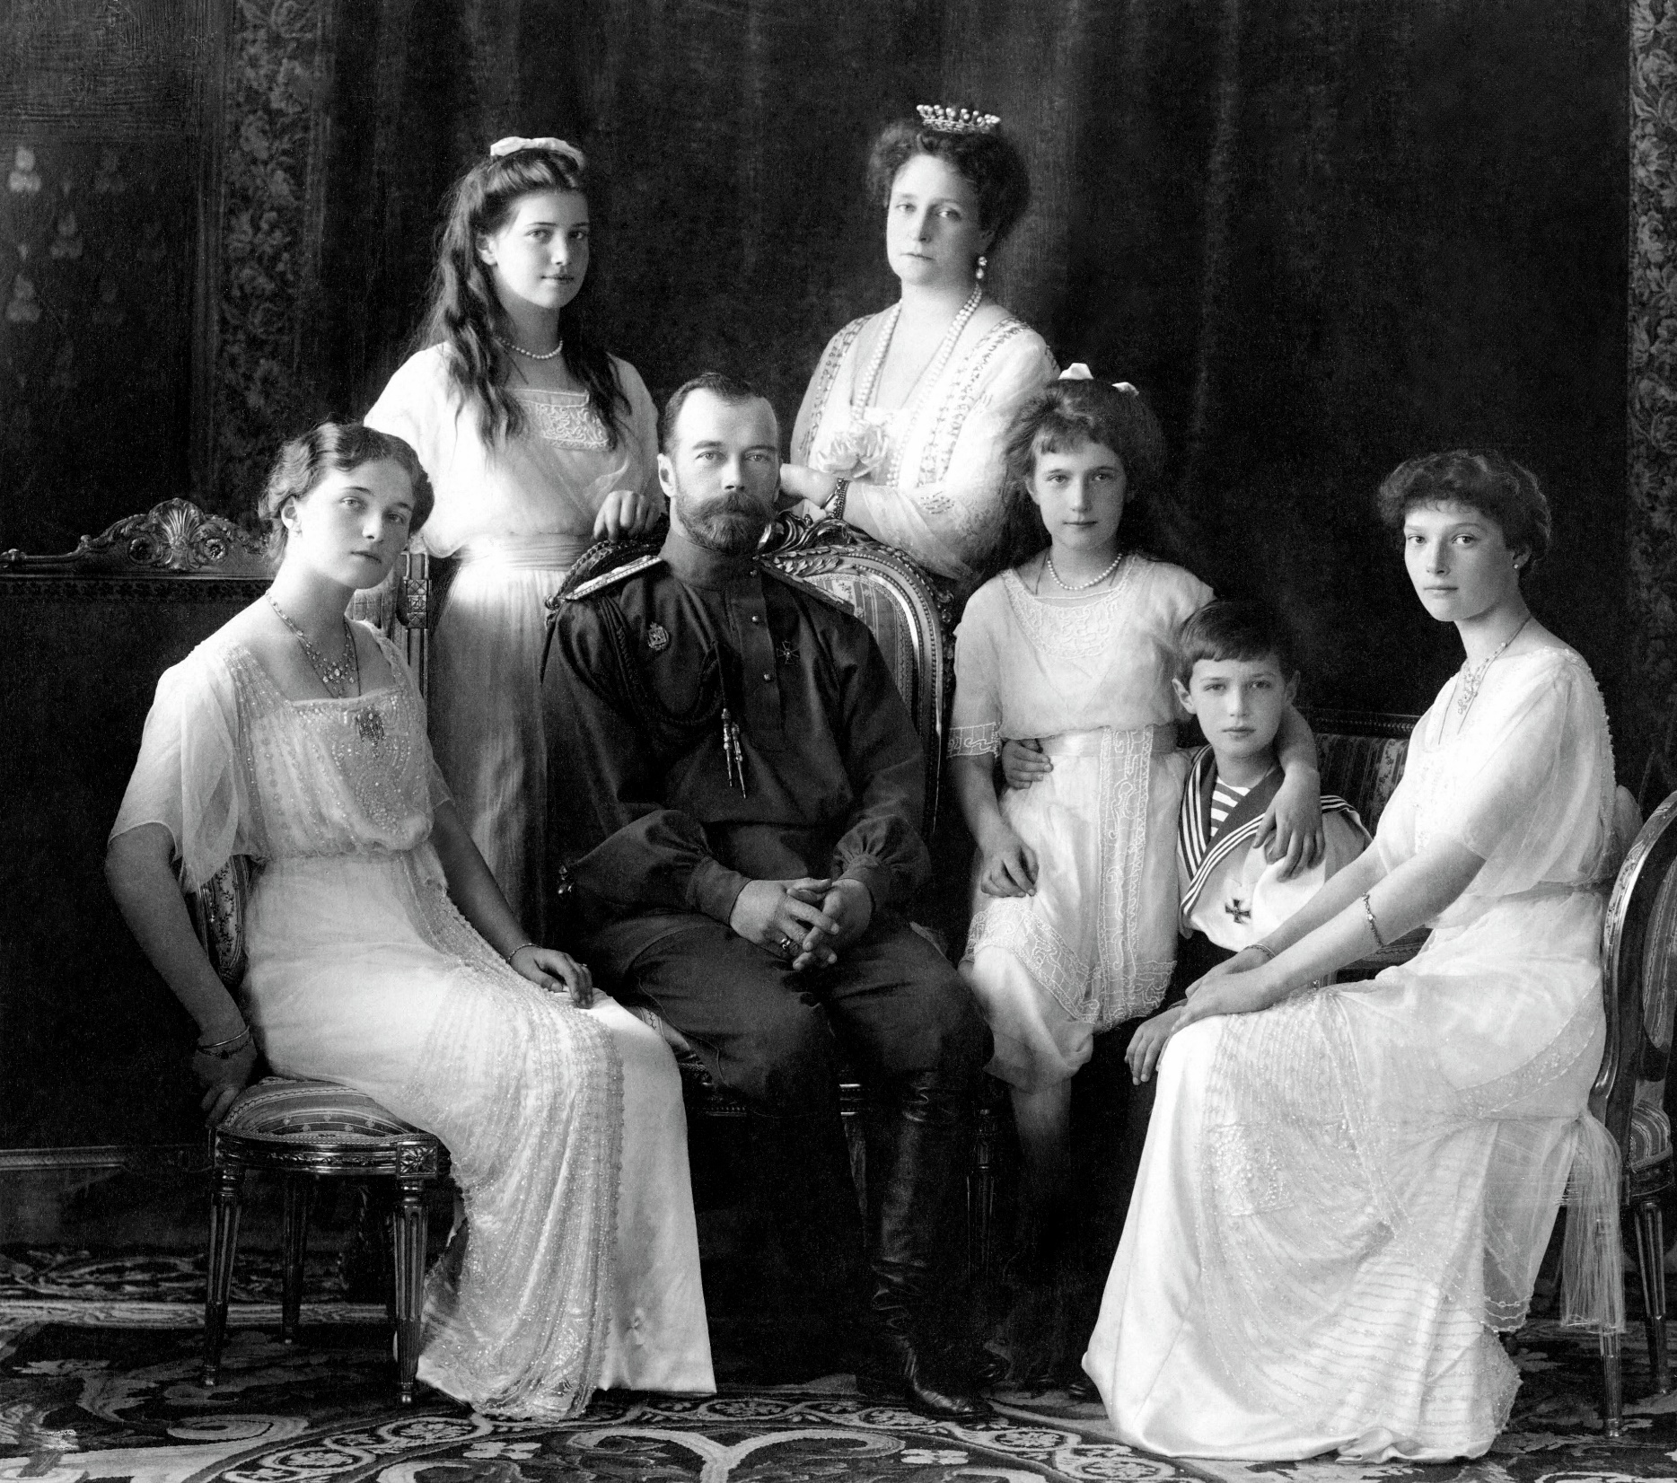

Slide 7
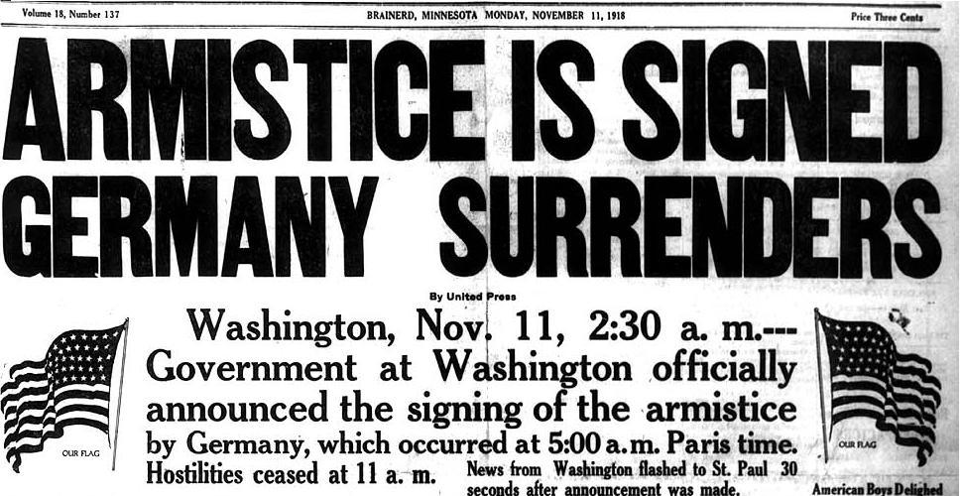
Armistice (1918)
*Ceasefire! Formal agreement of warring parties to stop fighting

Slide 8
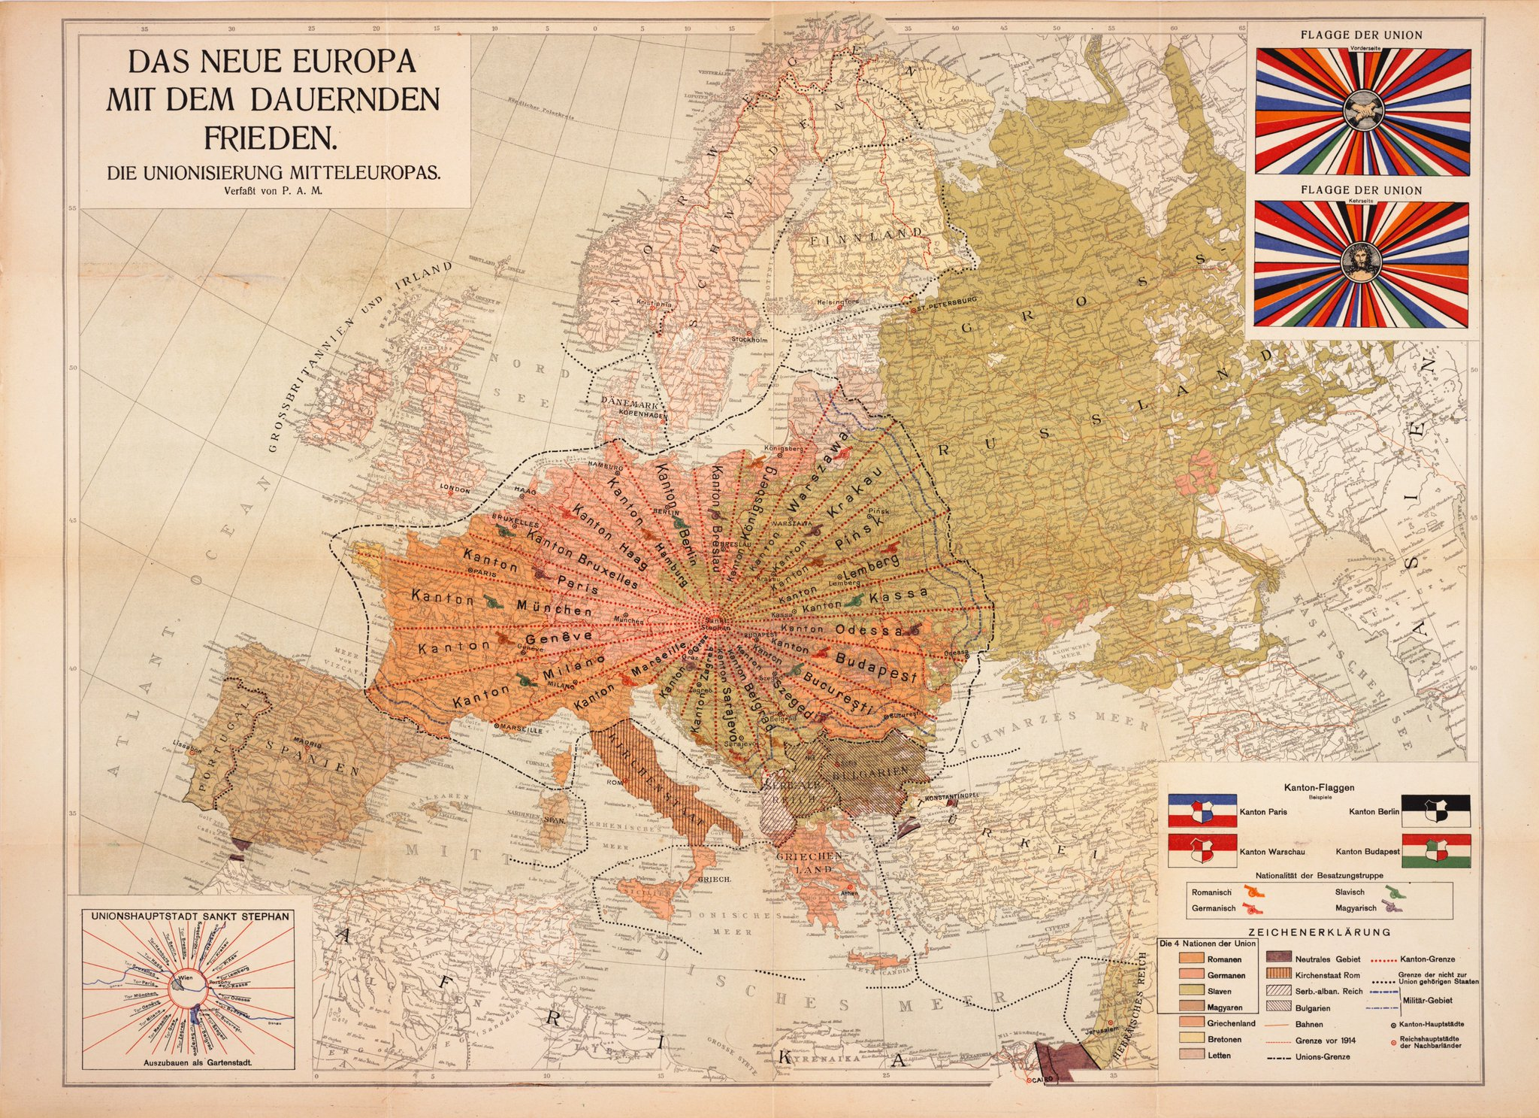
What to do now…
What a wonderfully bad idea.
Straight border lines are always a recipe for disaster.

Slide 9
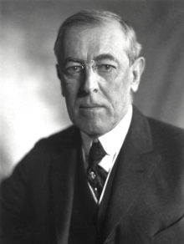
Woodrow Wilson’s 14 Points
*Peace plan…
Went easy on Germany
Freedom of the seas
Adjustment of colonial claims
Open diplomacy (no secrets!)
Arms reduction
Created League of Nations

Slide 10
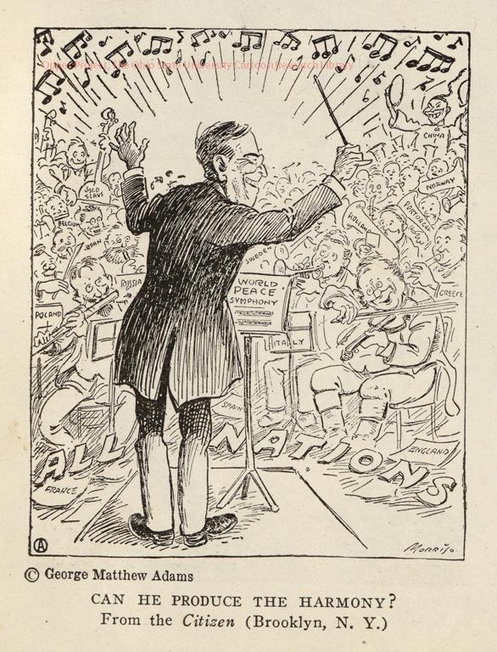

Slide 11
League of Nations
*An international organization formed in 1920 to promote cooperation and peace among nations

Slide 12
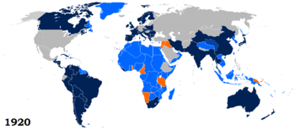

Slide 13
Treaty of Versailles (1919)
*Blamed Germany for WWI and demanded exorbitant reparations from the them
*U.S. did not ratify the treaty or join the league of nations.

Slide 14
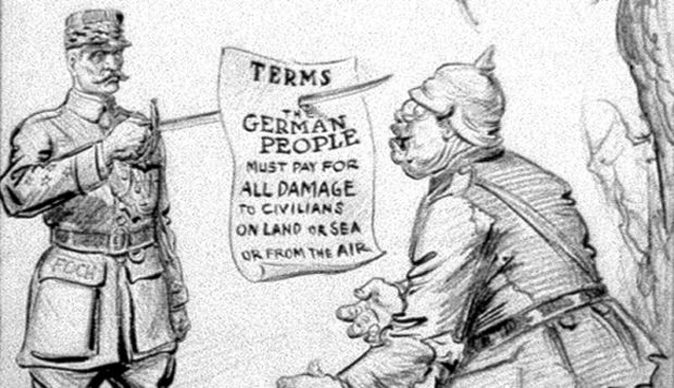

Slide 15
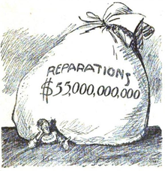

Slide 16
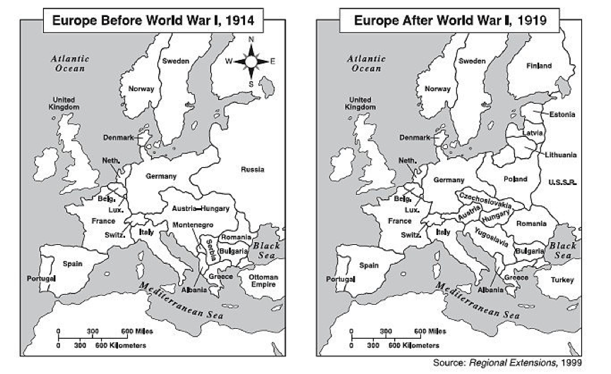

Slide 17
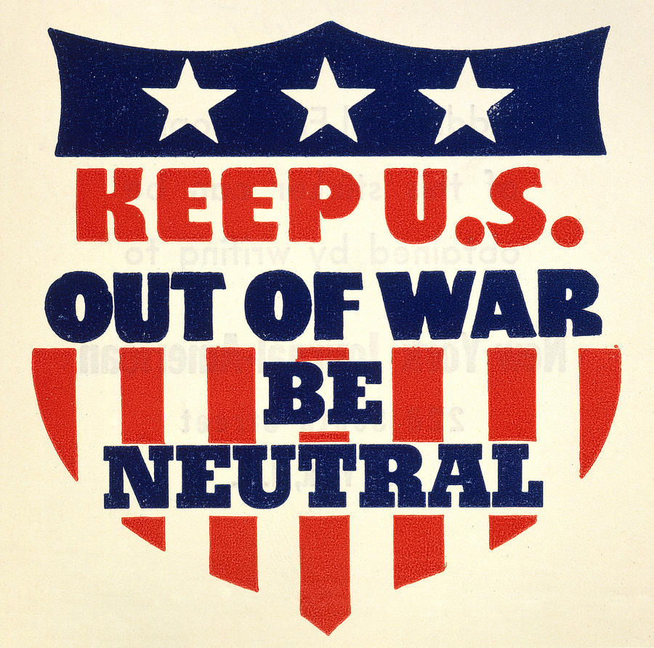
Isolationism
*U.S. foreign policy of nonparticipation in international economic and political relations after WWI
WHY?

Slide 18
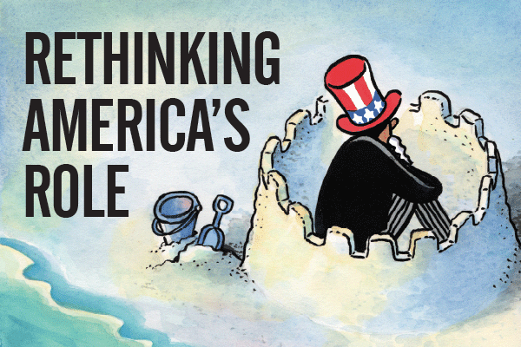

Slide 19
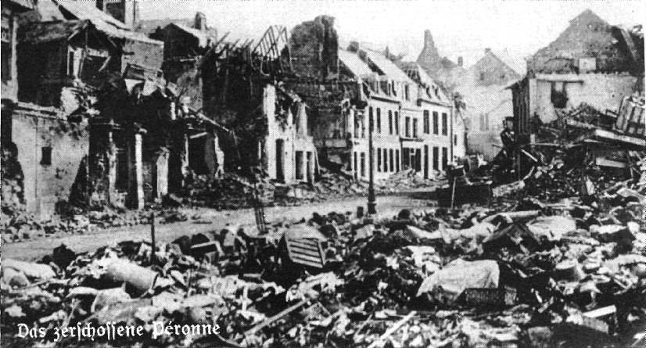

Slide 20
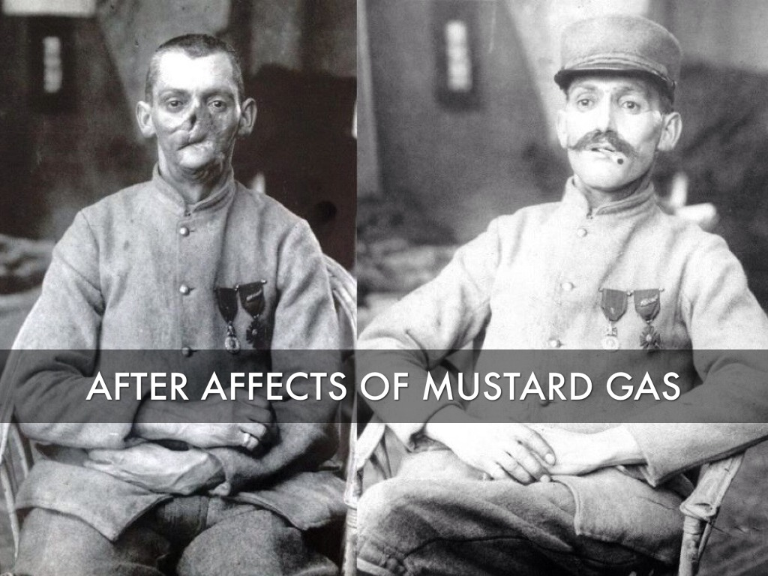

Slide 21
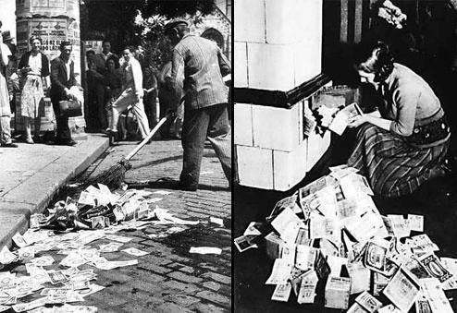

Slide 22
