Slide 1
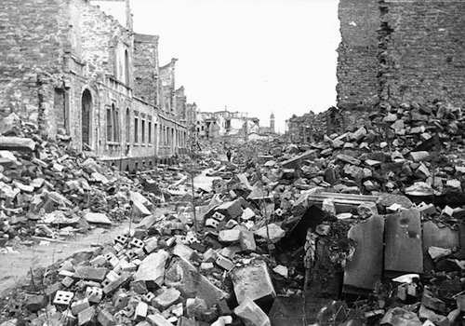
World War II
EFFECTS

Slide 2
Objects:
People:
Time/Title:
Inferences: Because I see ___________________, I can infer…
Conclusion: The most important thing in this image is _________________ because it sends the message that…

Slide 3
Homefront
• War production= women working, economy improved, sense of optimism
For groups discriminated against in the past, the war was a vehicle for lasting social and economic gains. For women and blacks in particular, the war was a stimulus—and a model—for future change.

Slide 4
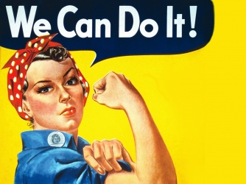

Slide 5
European Front
Hitler commits suicide and Nazi Germany surrenders in spring of 1945
Germany is split in half (East= communist under Soviet Union, West= democratic)

Slide 6
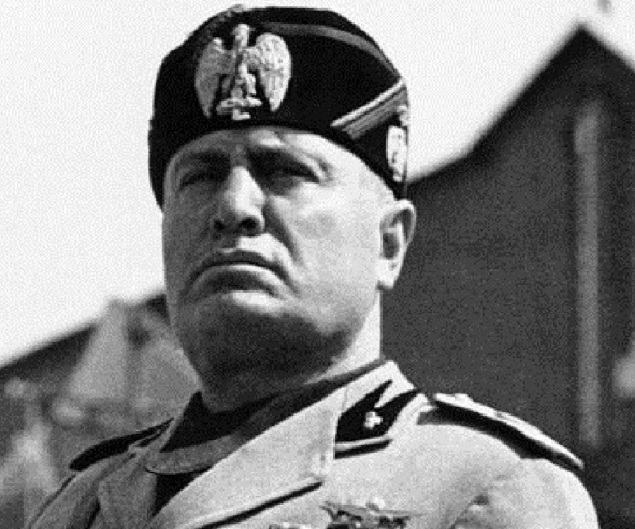
Benito Mussolini
Killed
April 1945

Slide 7
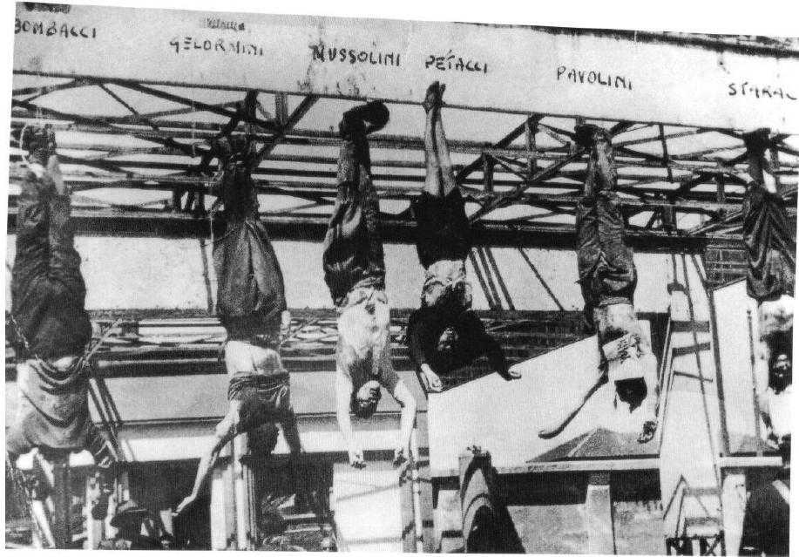

Slide 8
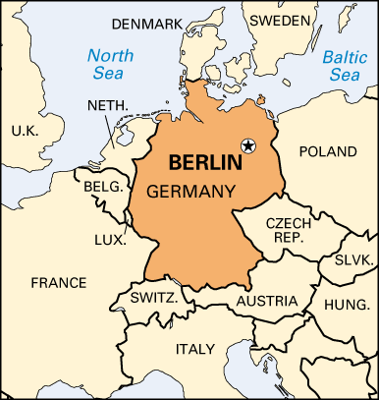
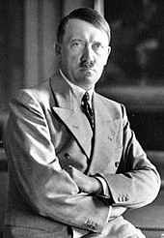

Slide 9
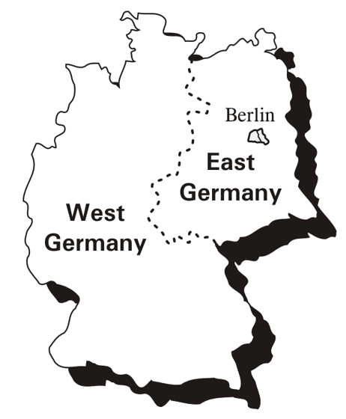
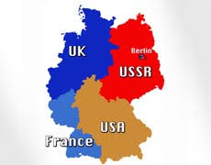

Slide 10
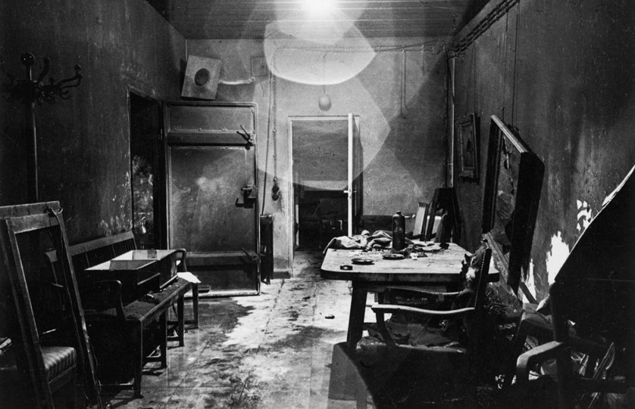

Slide 11
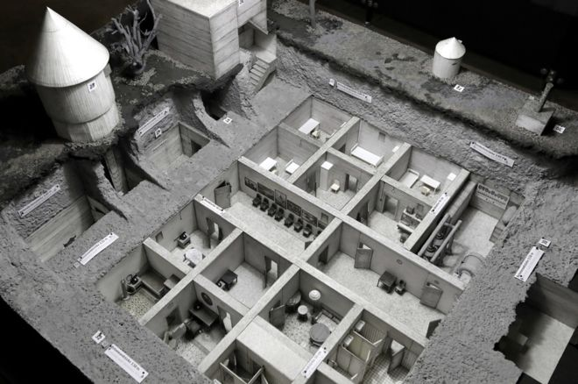

Slide 12
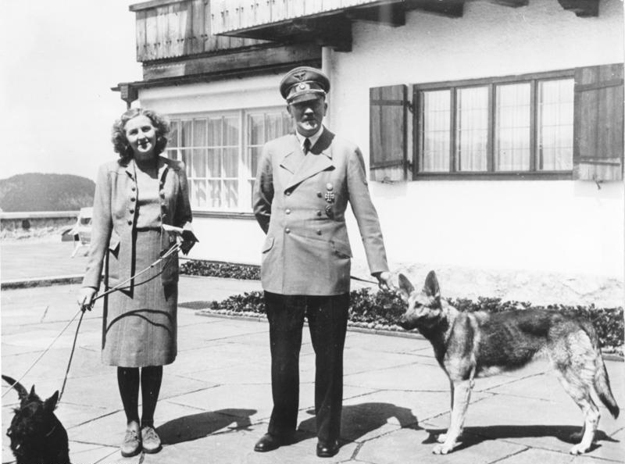

Slide 13
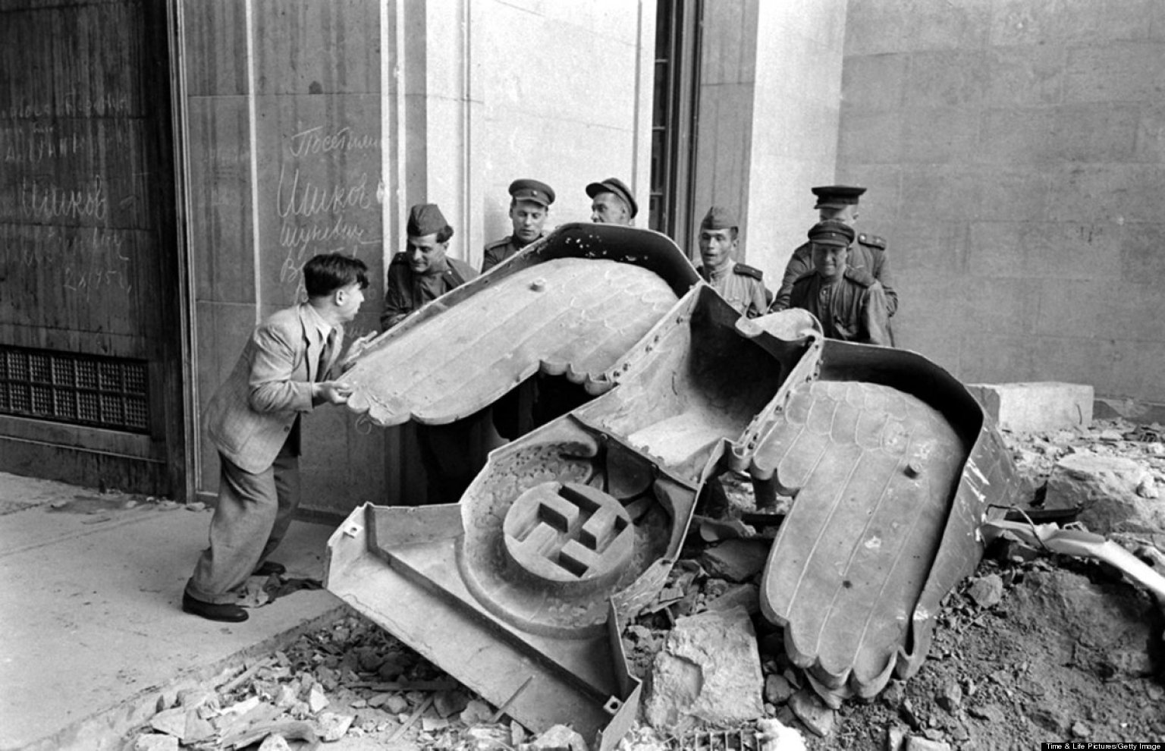

Slide 14
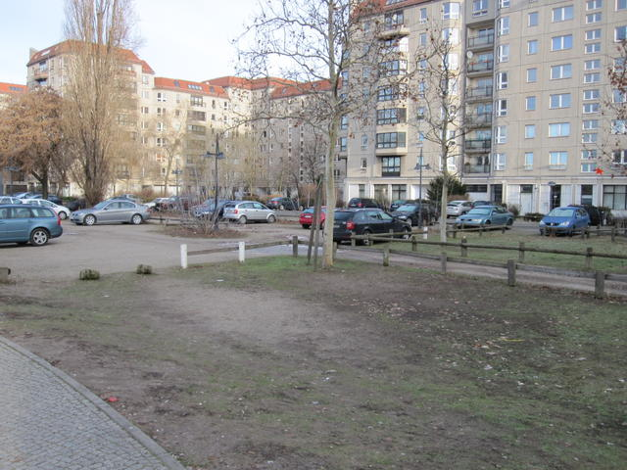

Slide 15
Pacific Front
U.S. General Douglas MacArthur occupies Japan= demilitarize and democratize
Constitutional Monarchy (Emperor no longer considered “divine”)
Removal of Japanese troops from foreign territories= China falls to communism under Mao Zedong

Slide 16
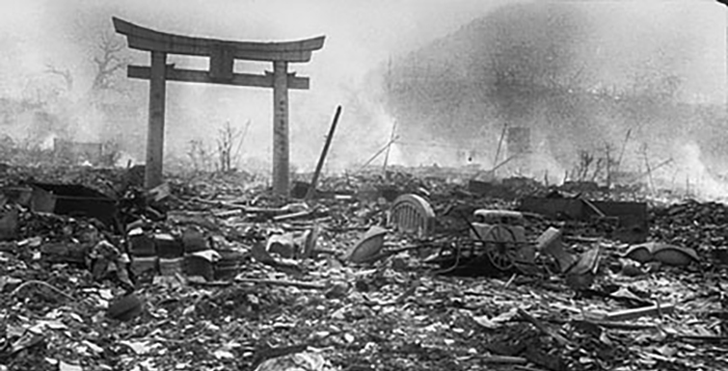

Slide 17
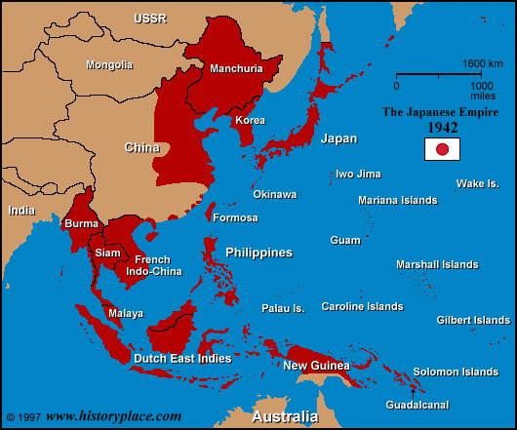

Slide 18
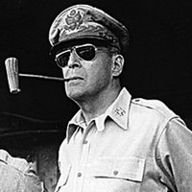
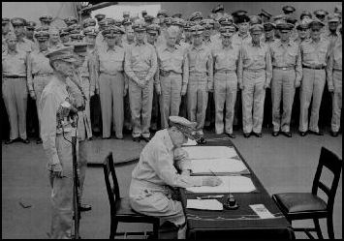

Slide 19
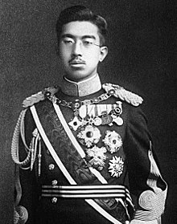
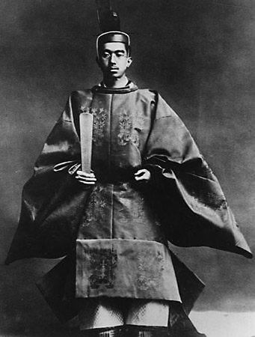
Emperor Hirohito

Slide 20
Liberation of Concentration Camps
The camps were liberated by the Allied forces between 1944 and 1945.
Estimated 15 million to 20 million people died or were imprisoned in Nazi Concentration Camps.
The first major camp was discovered by the advancing Soviets on July 23, 1944.
"There our troops found sights, sounds, and stenches horrible beyond belief, cruelties so enormous as to be incomprehensible to the normal mind.“

Slide 21
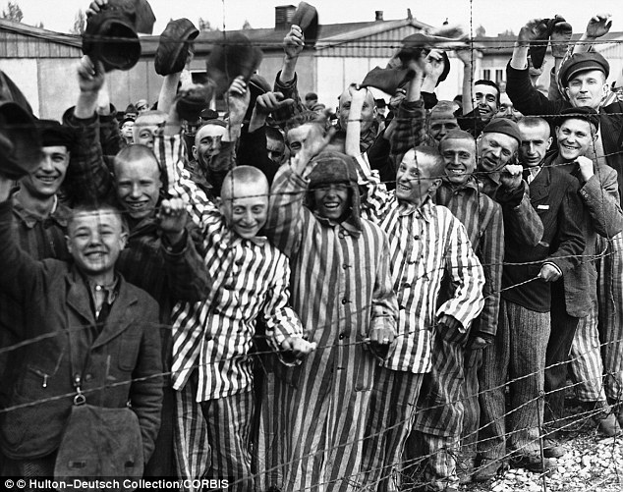

Slide 22
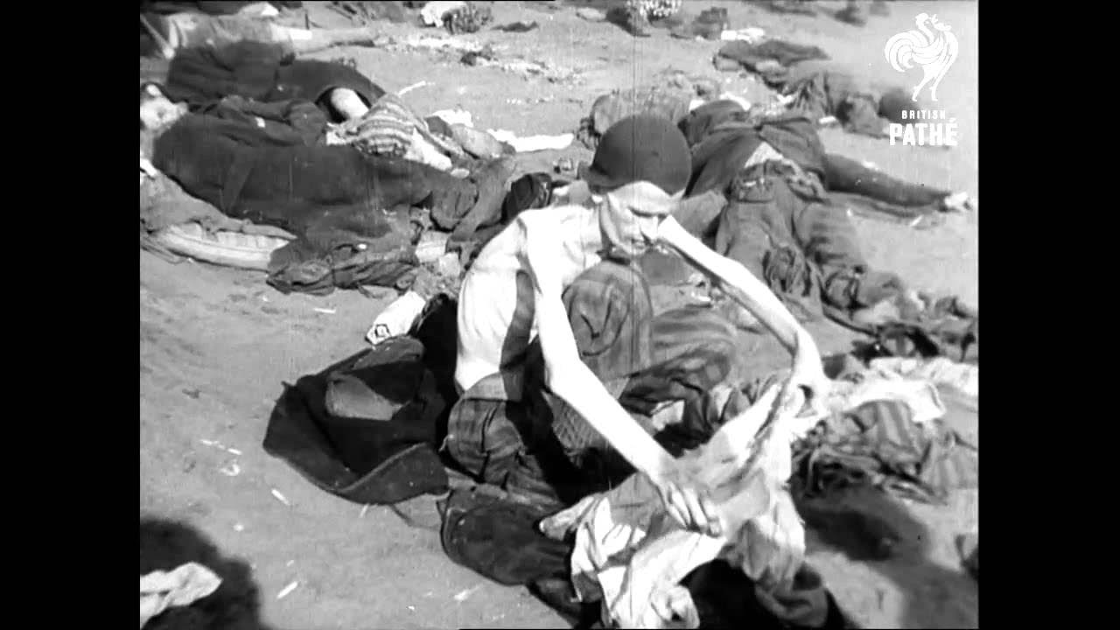

Slide 23
In most of the camps discovered by the Soviets, almost all the prisoners had already been removed, leaving only a few thousand alive—7,000 inmates were found in Auschwitz, including 180 children who had been experimented on by doctors. Some 60,000 prisoners were discovered at Bergen-Belsen by the British, 13,000 corpses lay unburied, and another 10,000 died from typhus or malnutrition over the following weeks. The British forced the remaining SS guards to gather up the corpses and place them in mass graves

Slide 24
Nuremberg Trials
Series of military trials held by the Allied forces to prosecute leaders of Nazi Germany and those who took part in the Holocaust/war crimes.
Crimes against humanity
Ten prominent members of the political and military leadership of Nazi Germany were executed by hanging but many committed suicide before or during the trials

Slide 25
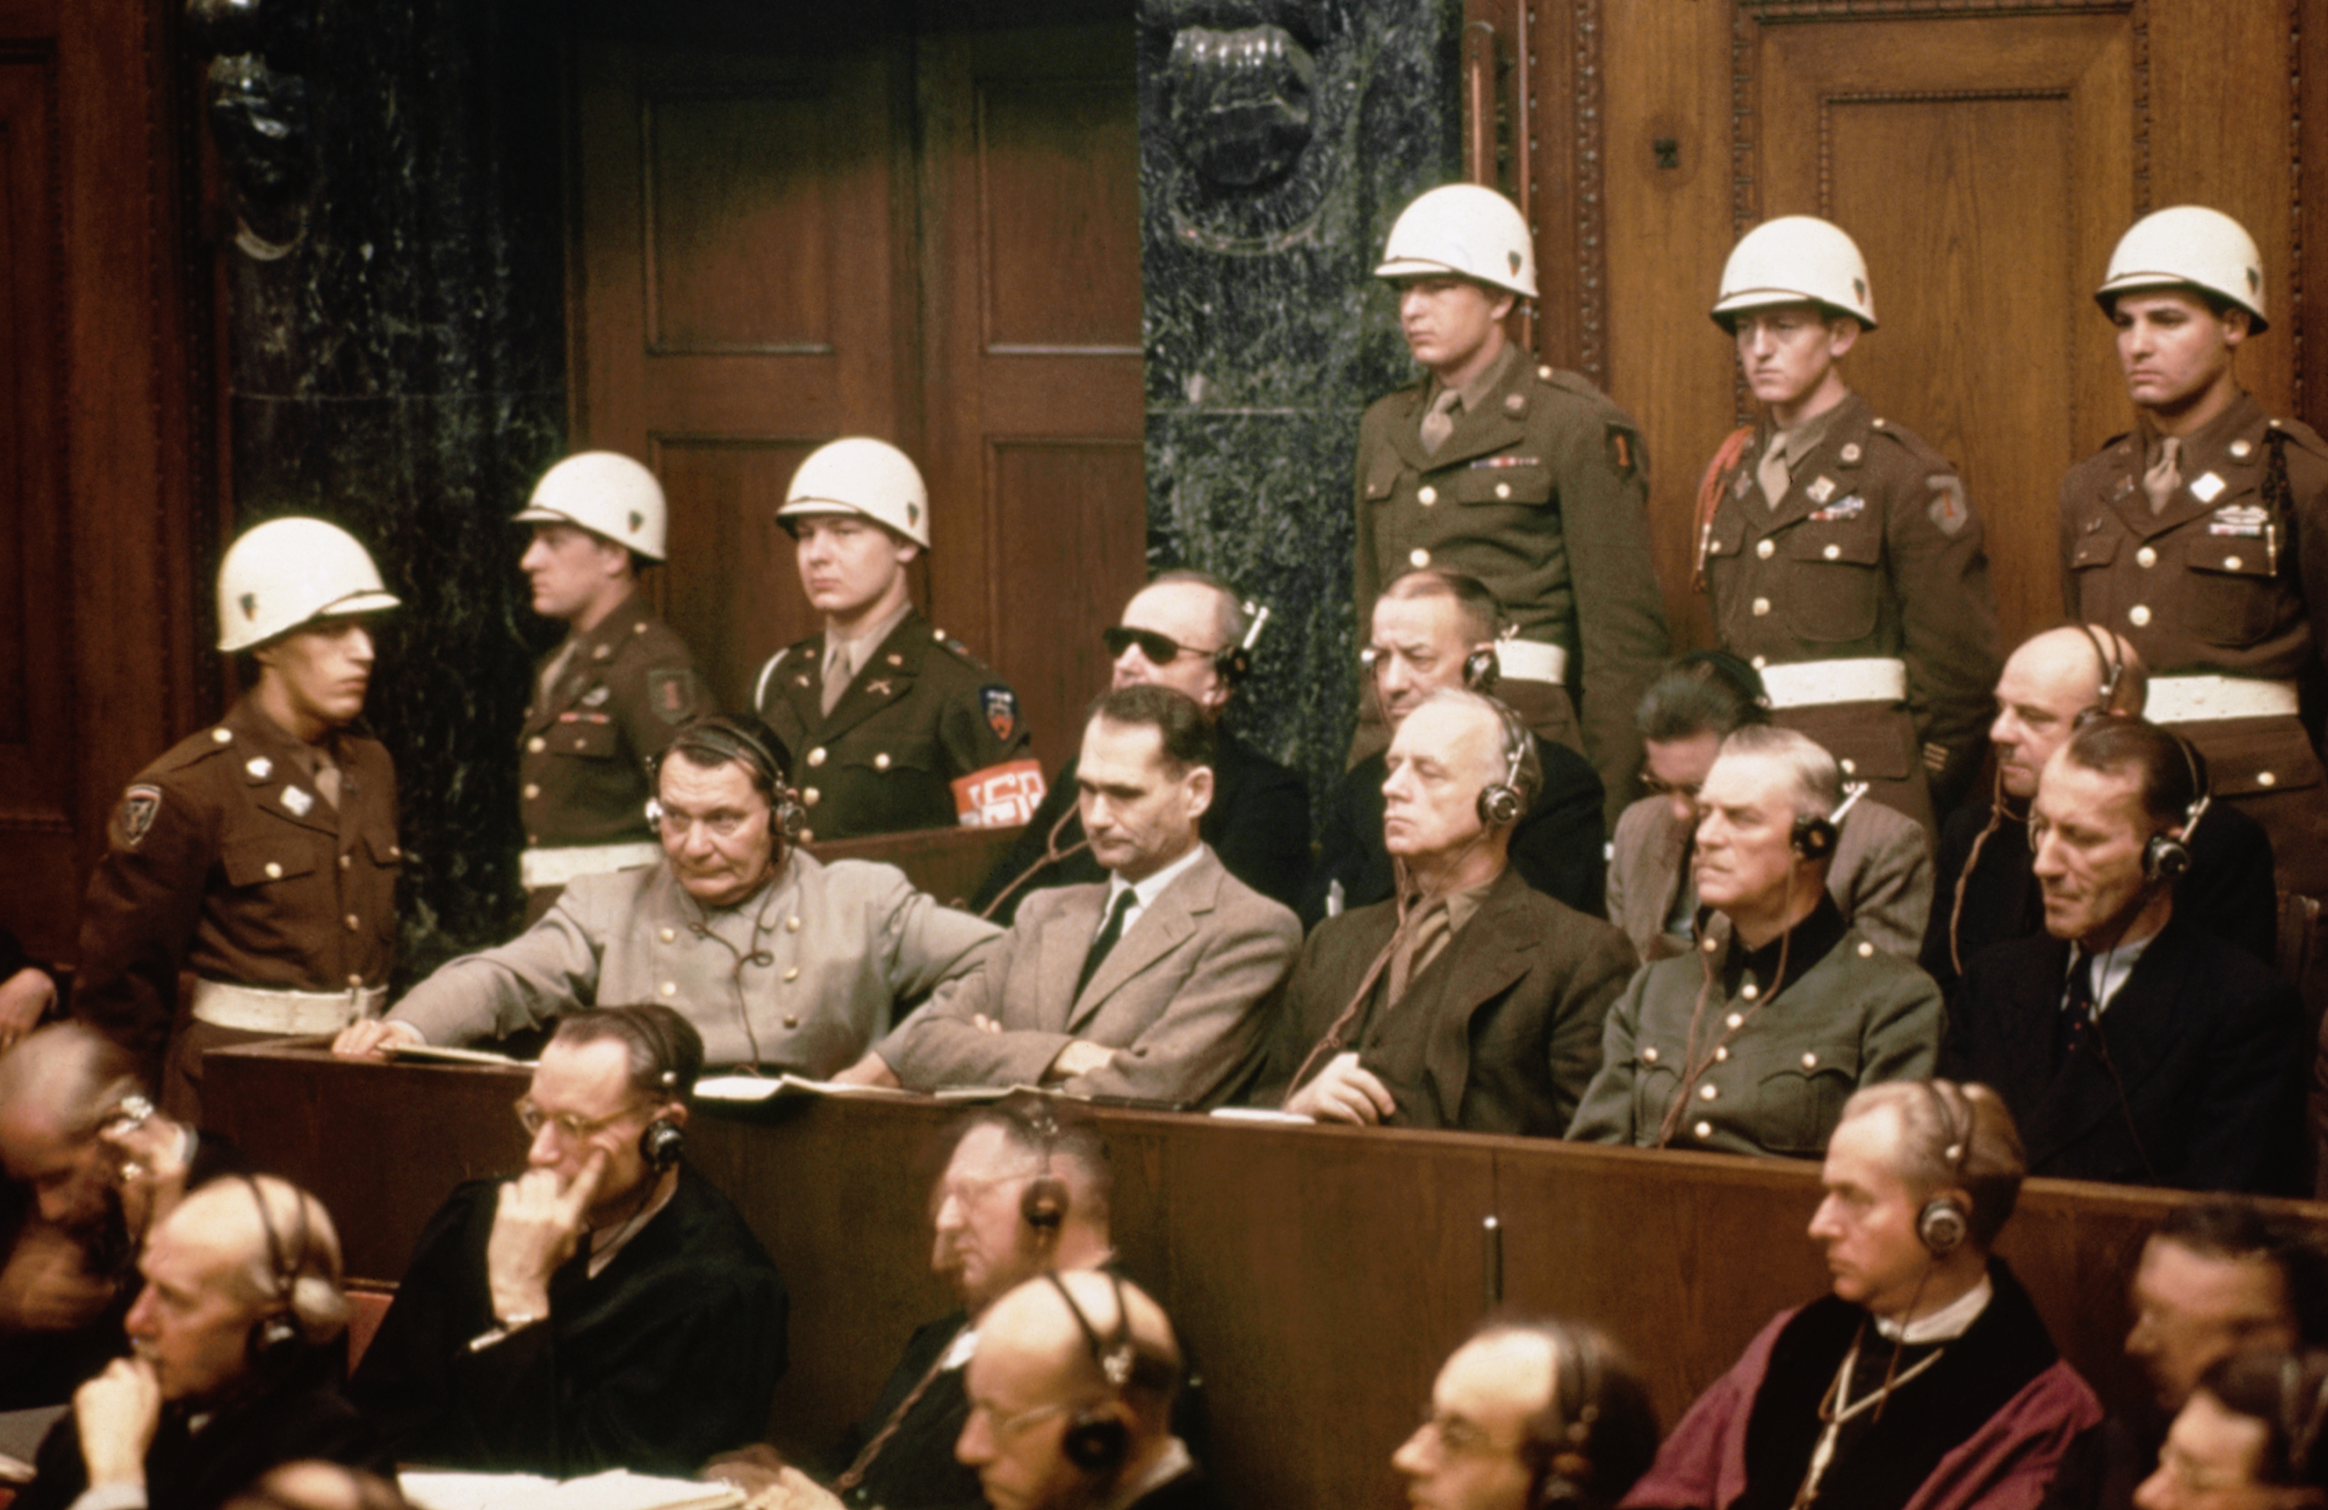

Slide 26
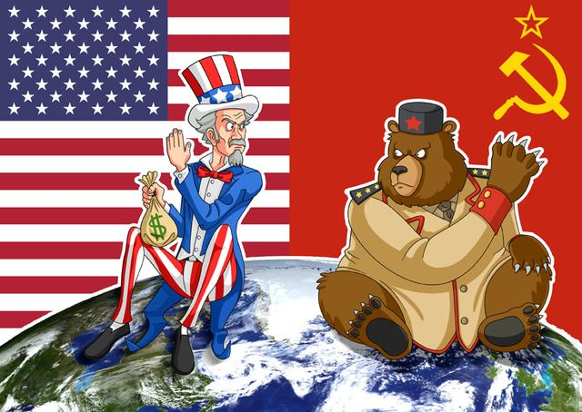
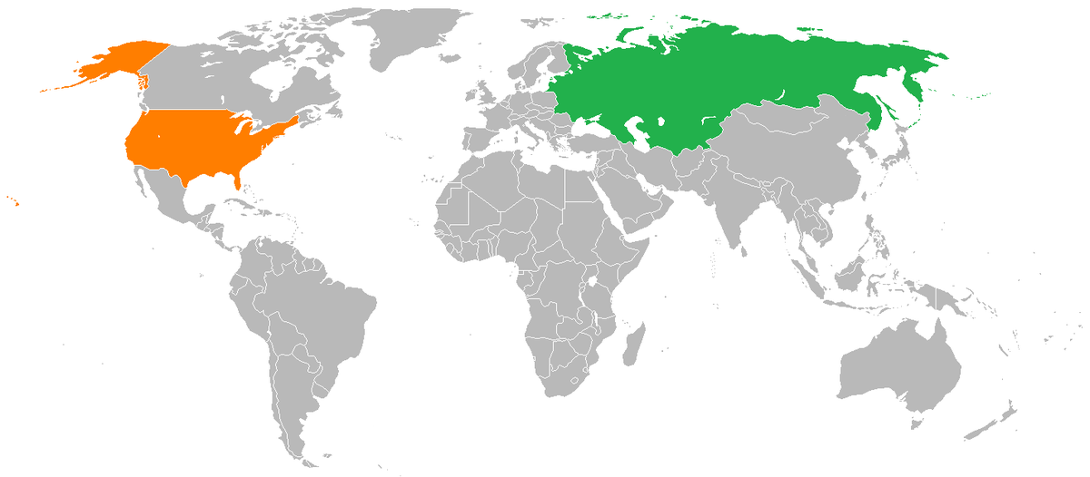
Two Super Powers and the Atomic Age Emerge
U.S. versus U.S.S.R. (Soviet Union)
Capitalism versus Communism
The Cold War

